Slide 1

Marketing Emails Q&A
SiriusMindShare
TEAM MEMBERS: Wendy & Lukas

Slide 2
Restaurant

Slide 3
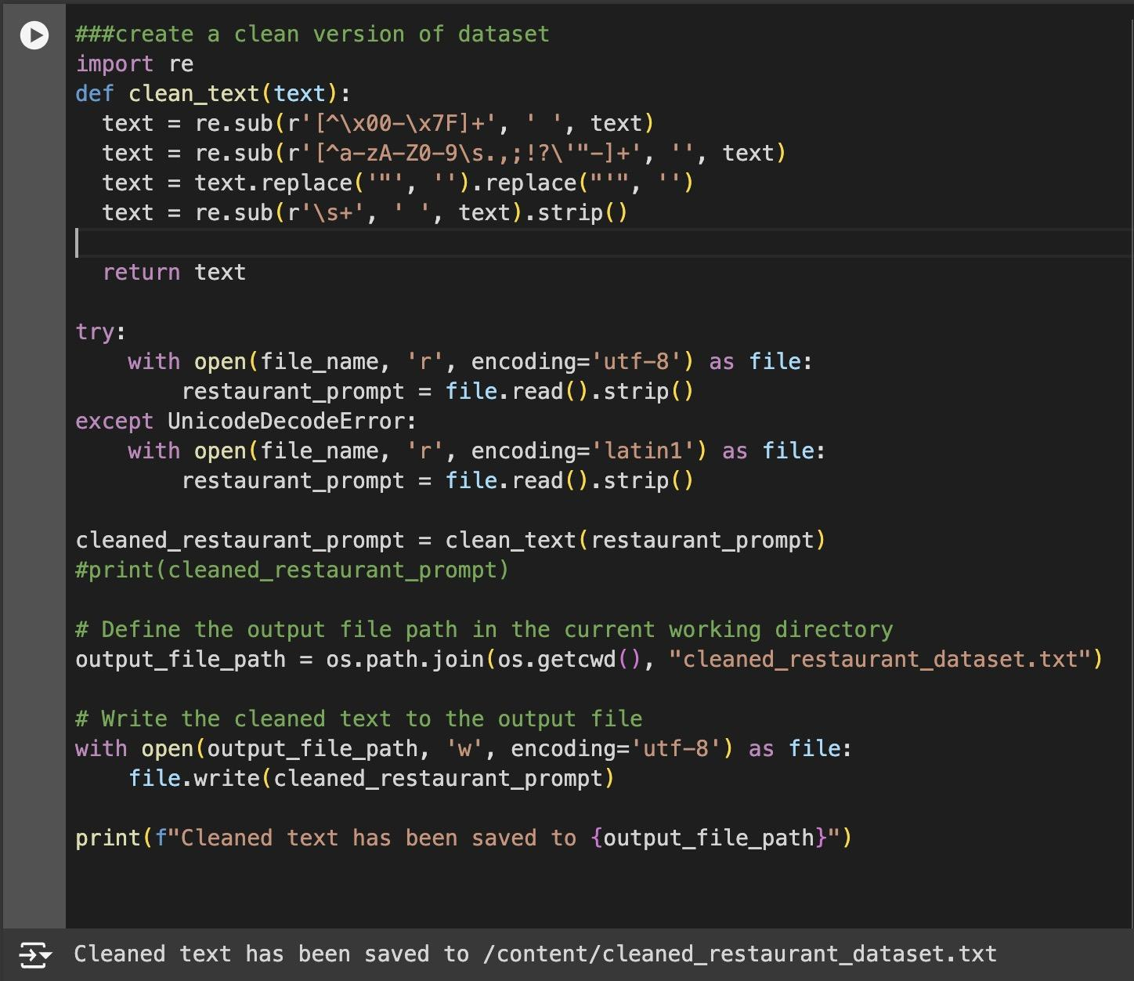
P
Set up for Restaurant Qs
product_id
product_name
category •
discounted_price
actual_price •
discount_percentage
rating•
rating_count
about_product
user_id•
user_name•
review_id
review_title•
review_content•
img_link•
product_link
| 3

Slide 4
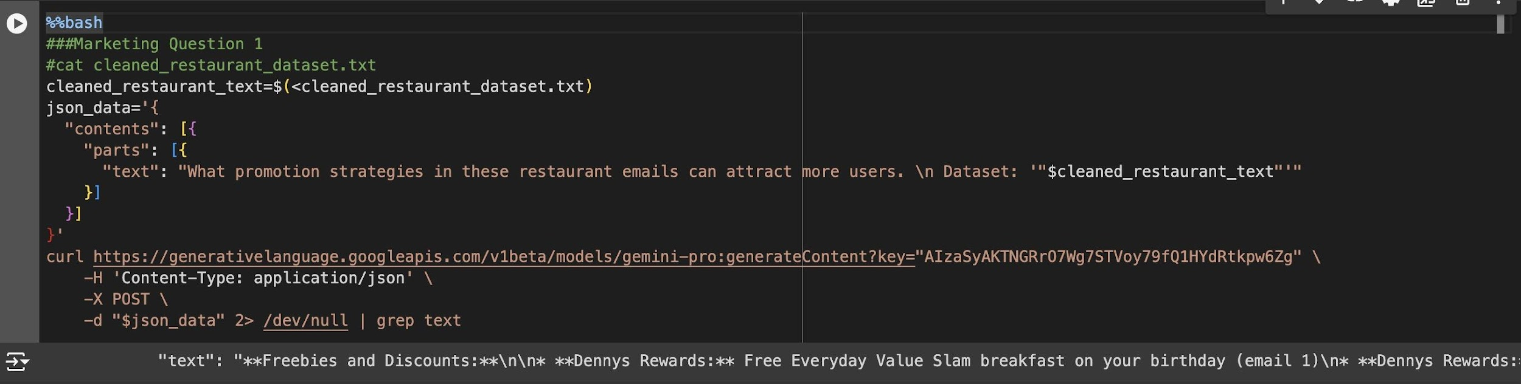
Question 1
1. What promotion strategies in these Resturant emails that can attract
more users？
Amazon Sales Dataset
The data of 1K+ Amazon Product's Ratings and Reviews as per their details listed on the official website of Amazon with 16 features as following:
product_id
product_name
category •
discounted_price
actual_price •
discount_percentage
rating•
rating_count
about_product
user_id•
user_name•
review_id
review_title•
review_content•
img_link•
product_link
| 3

Slide 5
Question 1
1. Exclusive Deals and Discounts:
Offer limited-time exclusive deals and discounts for first-time mobile orders (McDonald's, Habit Burger Grill).
Provide free meals or discounts for reaching certain spending milestones (Denny's, Kura Revolving Sushi Bar).
2. Loyalty Programs:
Reward customers with points, tiers, and exclusive benefits through membership programs (Chick-fil-A, Kura Revolving Sushi Bar).
Offer discounts or free items to members (Popeyes, Denny's).
3. Freebies and Deals:
Offer free items with minimum purchases (Denny's, Popeyes).
Provide discounts on delivery or zero delivery fees (Uber Eats, Postmates, Uber One).
Host events with freebies or special offers (Denny's, Boathouse at Hendry's Beach).
4. Targeted Promotions:
Segment customers and offer promotions based on their preferences (Safeway, Yelp).
Provide offers for specific events or holidays (Universal Studios Hollywood).
5. Partnerships and Collaborations:
Partner with other businesses to offer joint promotions (Amazon.com, Grubhub).
Offer discounts or exclusive deals to users of specific apps or payment methods (Uber Eats, Uber One).
6. Contests and Sweepstakes:
Run contests or sweepstakes to generate excitement and attract new customers (Kura Revolving Sushi Bar).
7. Personalized Recommendations and Content:
Use algorithms to provide personalized recommendations and content to customers based on their preferences (Yelp).
Share recipes, articles, and other engaging content to foster connection with customers (Amazon.com).
Amazon Sales Dataset
The data of 1K+ Amazon Product's Ratings and Reviews as per their details listed on the official website of Amazon with 16 features as following:
product_id
product_name
category •
discounted_price
actual_price •
discount_percentage
rating•
rating_count
about_product
user_id•
user_name•
review_id
review_title•
review_content•
img_link•
product_link
| 3

Slide 6
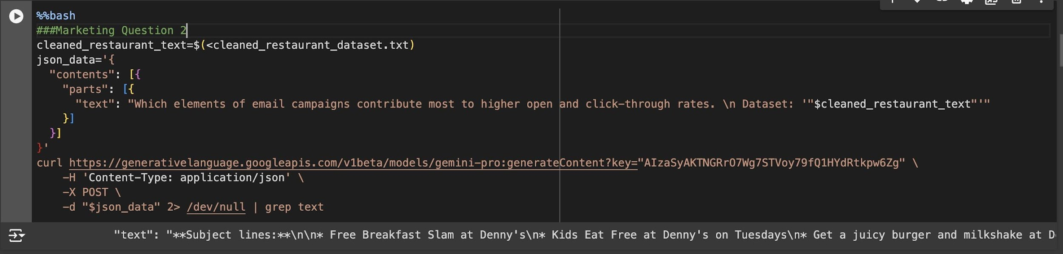
Question 2
2. Which elements of email campaigns contribute most to higher open and
click-through rates?
Amazon Sales Dataset
The data of 1K+ Amazon Product's Ratings and Reviews as per their details listed on the official website of Amazon with 16 features as following:
product_id
product_name
category •
discounted_price
actual_price •
discount_percentage
rating•
rating_count
about_product
user_id•
user_name•
review_id
review_title•
review_content•
img_link•
product_link
| 3

Slide 7
Question 2
1. Personalized Subject Lines:
Emails with personalized subject lines that include the recipient's name or other relevant information have a higher open rate.
Example: Email 3 from Denny's Rewards uses the subject line “Whether you’re hitting the road or staycation-ing, we’ve got breakfast and dinner covered” which is more likely to be opened by recipients interested in travel-related offers.
2. Clear and Concise Copy:
Emails with clear and concise copy are more likely to be read by recipients.
Example: Email 5 from Denny's Rewards uses a simple and easy-to-understand subject line “Beat the Daylight Saving slump with BOGO Sweet Cream Cold Brew” and provides a brief overview of the offer in the body of the email.
3. Use of Images and Videos:
Emails with images and videos are more visually appealing and engaging, which can lead to higher open rates.
Example: Email 9 from Universal Studios Hollywood uses a colorful image of the Super Mario World theme park in the header, which is likely to grab the attention of recipients interested in this type of entertainment.
4. Call to Action:
Emails with a clear call to action are more likely to result in click-throughs.
Example: Email 15 from The Habit Burger Grill includes a clear call to action “Enjoy Your Free Charburger 🍔!”.
5. Use of Incentives:
Emails that offer incentives, such as discounts or freebies, are more likely to be opened and clicked on.
Example: Email 31 from Kura Revolving Sushi Bar includes a 20% off coupon, which is likely to entice recipients to open and read the email.
Amazon Sales Dataset
The data of 1K+ Amazon Product's Ratings and Reviews as per their details listed on the official website of Amazon with 16 features as following:
product_id
product_name
category •
discounted_price
actual_price •
discount_percentage
rating•
rating_count
about_product
user_id•
user_name•
review_id
review_title•
review_content•
img_link•
product_link
| 3

Slide 8
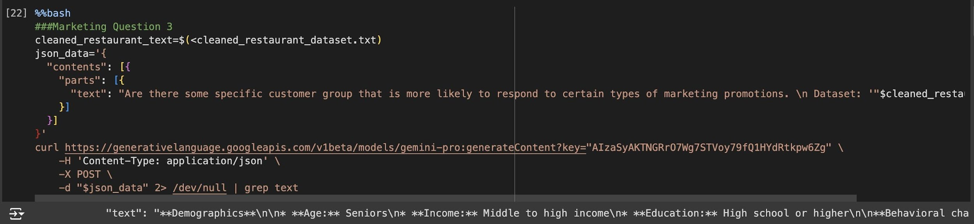
Question 3
3. Are there some specific customer group that is more likely to respond
to certain types of marketing promotions?
Amazon Sales Dataset
The data of 1K+ Amazon Product's Ratings and Reviews as per their details listed on the official website of Amazon with 16 features as following:
product_id
product_name
category •
discounted_price
actual_price •
discount_percentage
rating•
rating_count
about_product
user_id•
user_name•
review_id
review_title•
review_content•
img_link•
product_link
| 3

Slide 9
Question 3
1. Birthday individuals:
Email 1
2. Parents with children:
Email 2
3. Travelers:
Email 3
4. Loyalty program members:
Emails 4, 12, 15, 17, 21, 23, 24, 29, 33
5. Coffee lovers:
Email 5
6. Families:
Email 9
7. Grocery shoppers:
Email 10
8. Rainy day enthusiasts:
Email 11
9. New Uber users:
Email 14
10. Pizza lovers:
Email 16
11. Foodies:
Email 18
12. Seafood enthusiasts:
Email 30
13. Valentine's Day celebrants:
Email 31
14. Kura Revolving Sushi Bar loyalty program members with unused coupons:
Email 33
Amazon Sales Dataset
The data of 1K+ Amazon Poduct's Ratings and Reviews as per their details listed on the official website of Amazon with 16 features as following:
product_id
product_name
category •
discounted_price
actual_price •
discount_percentage
rating•
rating_count
about_product
user_id•
user_name•
review_id
review_title•
review_content•
img_link•
product_link
| 3

Slide 10
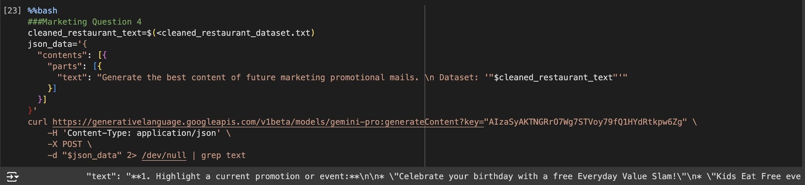
Question 4
4. Generate the best content of future marketing promotional mails
Amazon Sales Dataset
The data of 1K+ Amazon Product's Ratings and Reviews as per their details listed on the official website of Amazon with 16 features as following:
product_id
product_name
category •
discounted_price
actual_price •
discount_percentage
rating•
rating_count
about_product
user_id•
user_name•
review_id
review_title•
review_content•
img_link•
product_link
| 3

Slide 11
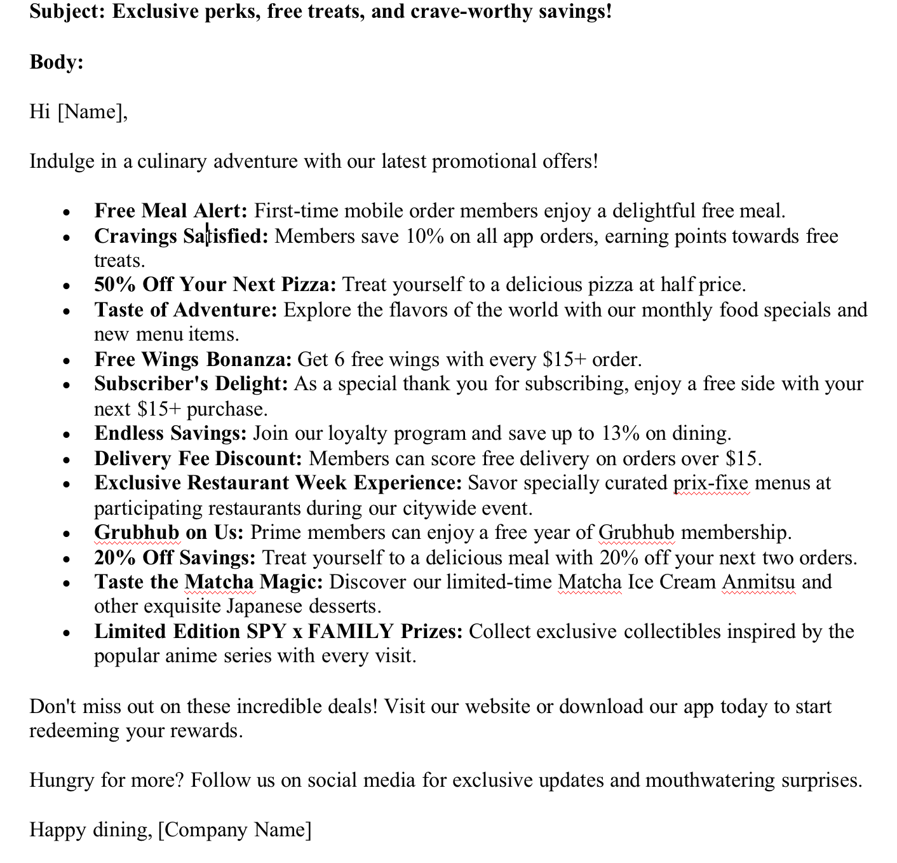
Question 4
Amazon Sales Dataset
The data of 1K+ Amazon Product's Ratings and Reviews as per their details listed on the official website of Amazon with 16 features as following:
product_id
product_name
category •
discounted_price
actual_price •
discount_percentage
rating•
rating_count
about_product
user_id•
user_name•
review_id
review_title•
review_content•
img_link•
product_link
| 3

Slide 12
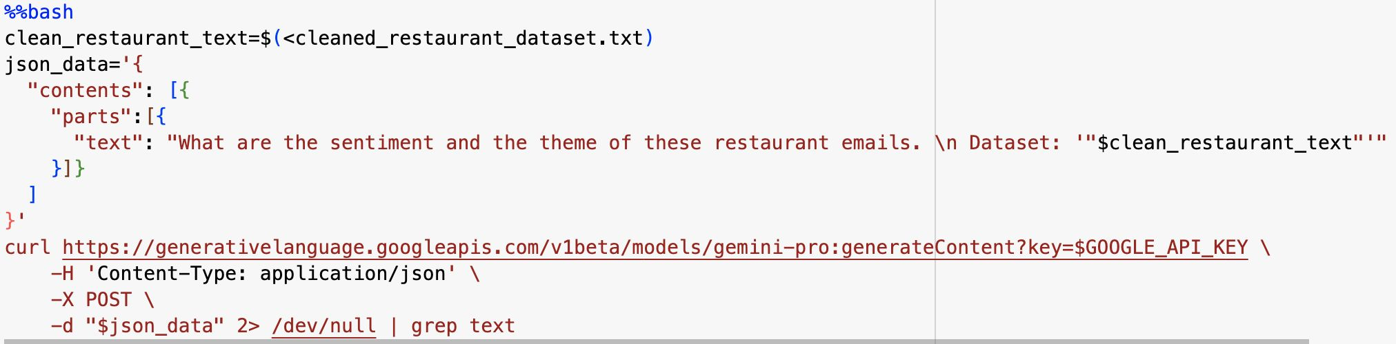
Question 5
5. What are the sentiment and the theme of restaurant emails?
Amazon Sales Dataset
The data of 1K+ Amazon Product's Ratings and Reviews as per their details listed on the official website of Amazon with 16 features as following:
product_id
product_name
category •
discounted_price
actual_price •
discount_percentage
rating•
rating_count
about_product
user_id•
user_name•
review_id
review_title•
review_content•
img_link•
product_link
| 3

Slide 13
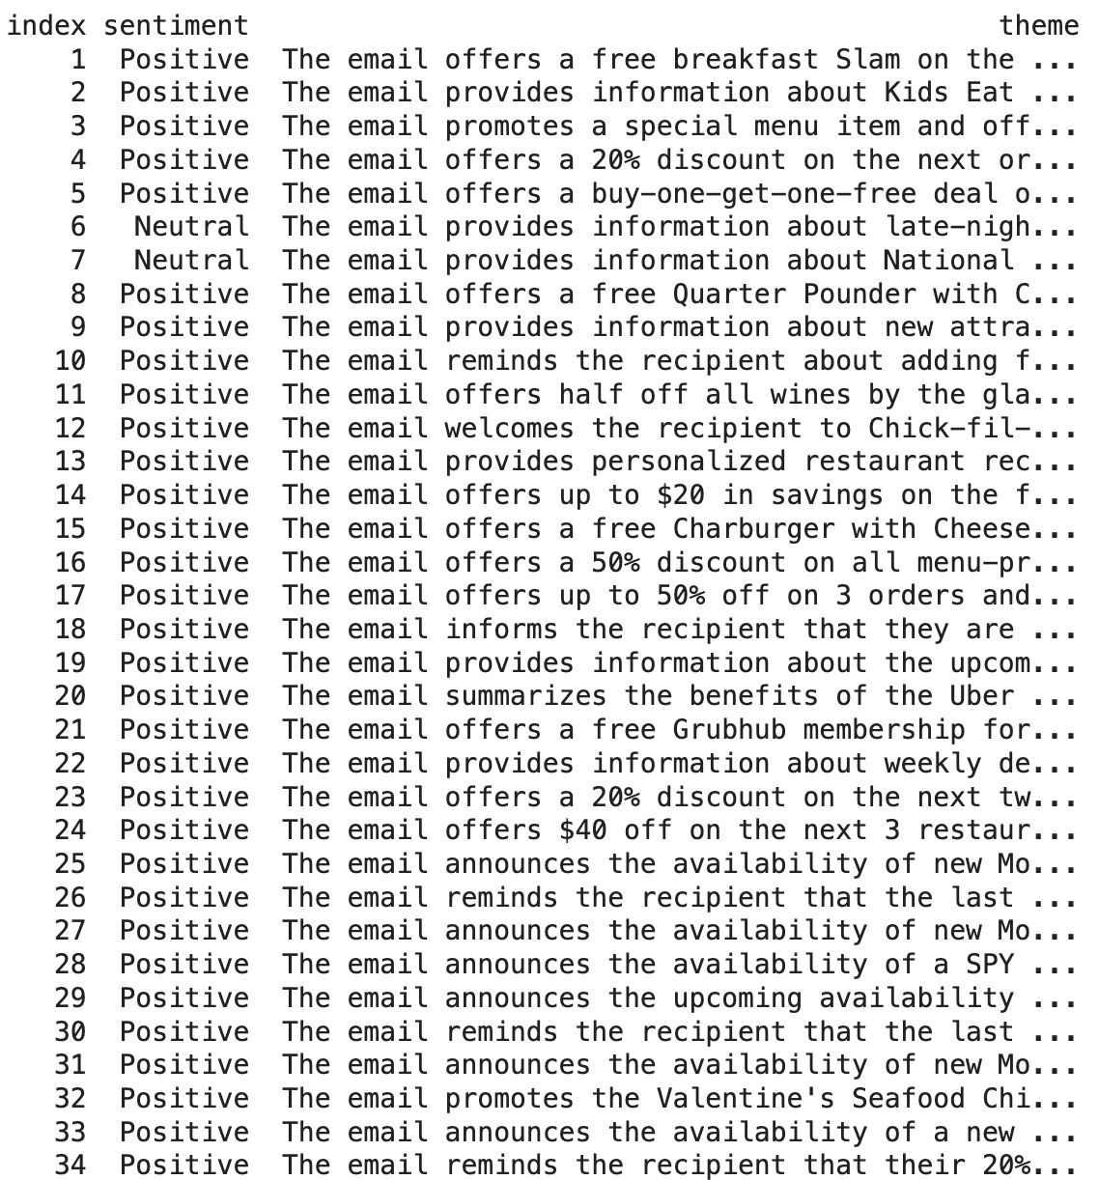
Question 5
Amazon Sales Dataset
The data of 1K+ Amazon Poduct's Ratings and Reviews as per their details listed on the official website of Amazon with 16 features as following:
Positive > Negative
product_id
product_name
category •
discounted_price
actual_price •
discount_percentage
rating•
rating_count
about_product
user_id•
user_name•
review_id
review_title•
review_content•
img_link•
product_link
| 3

Slide 14
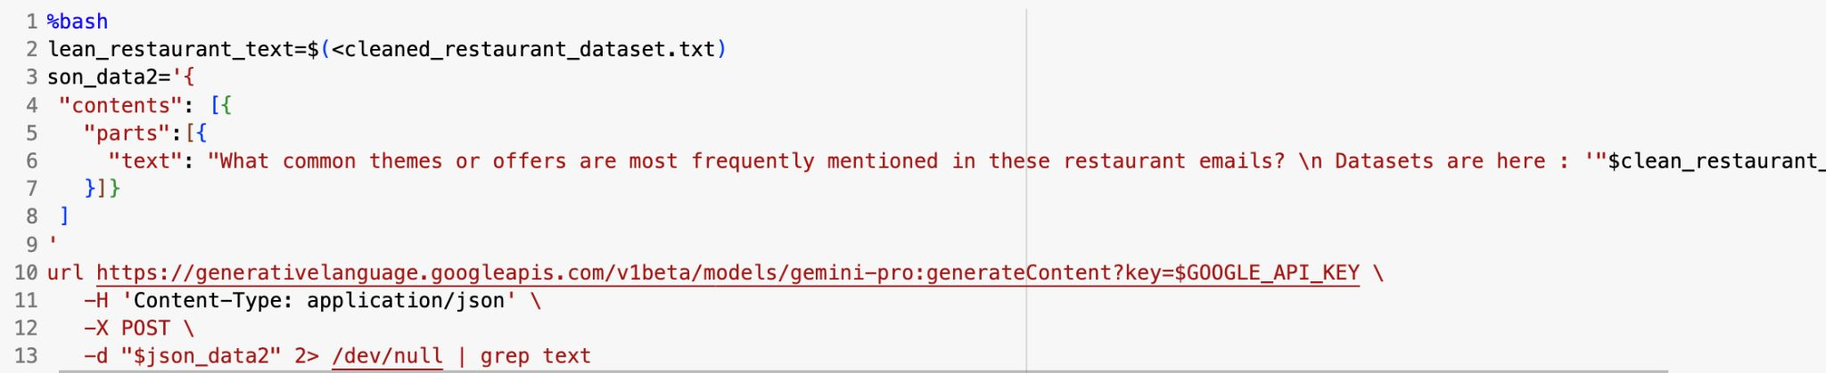
Question 6
6. What common themes or offers are most frequently mentioned in these restaurant emails?
Amazon Sales Dataset
The data of 1K+ Amazon Product's Ratings and Reviews as per their details listed on the official website of Amazon with 16 features as following:
product_id
product_name
category •
discounted_price
actual_price •
discount_percentage
rating•
rating_count
about_product
user_id•
user_name•
review_id
review_title•
review_content•
img_link•
product_link
| 3

Slide 15
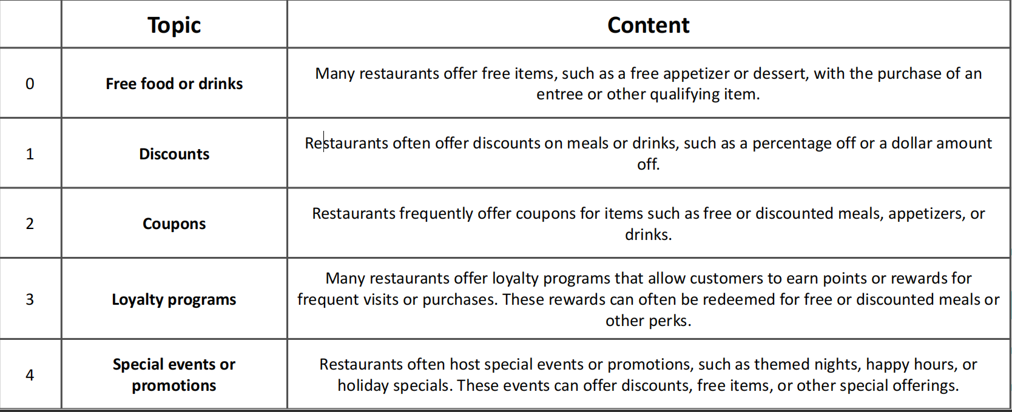
Question 6
Amazon Sales Dataset
The data of 1K+ Amazon Poduct's Ratings and Reviews as per their details listed on the official website of Amazon with 16 features as following:
product_id
product_name
category •
discounted_price
actual_price •
discount_percentage
rating•
rating_count
about_product
user_id•
user_name•
review_id
review_title•
review_content•
img_link•
product_link
| 3

Slide 16
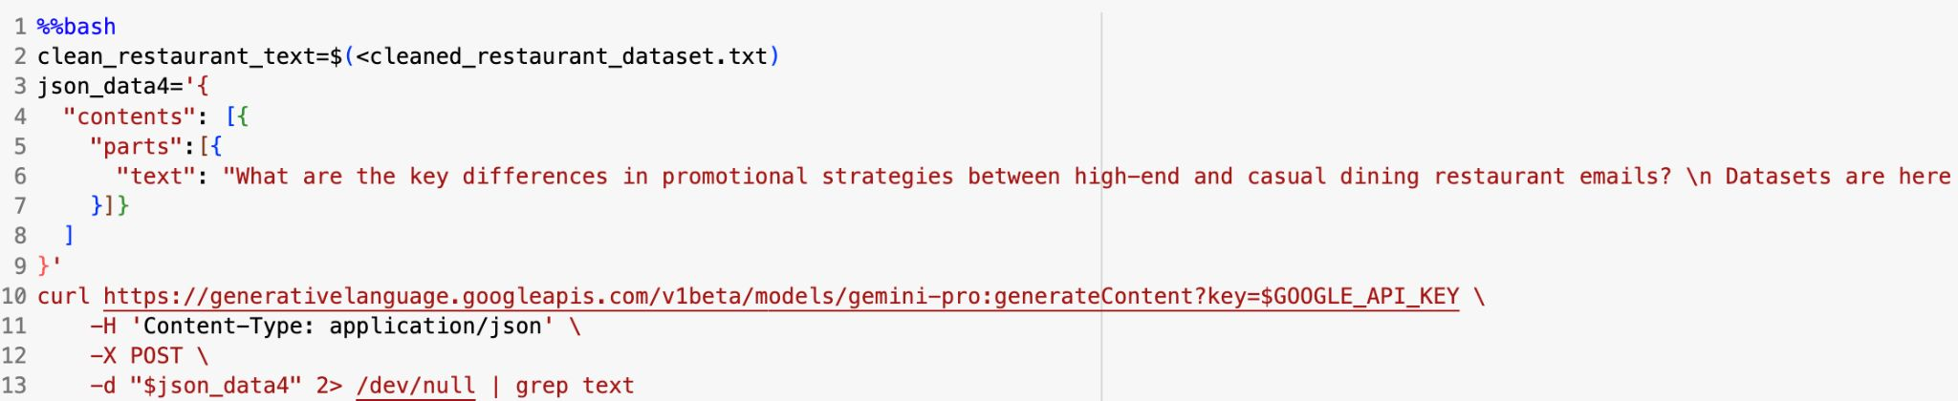
Question 7
7. What are the differences in strategies between high-end and casual dining restaurant emails?
Amazon Sales Dataset
The data of 1K+ Amazon Product's Ratings and Reviews as per their details listed on the official website of Amazon with 16 features as following:
product_id
product_name
category •
discounted_price
actual_price •
discount_percentage
rating•
rating_count
about_product
user_id•
user_name•
review_id
review_title•
review_content•
img_link•
product_link
| 3

Slide 17
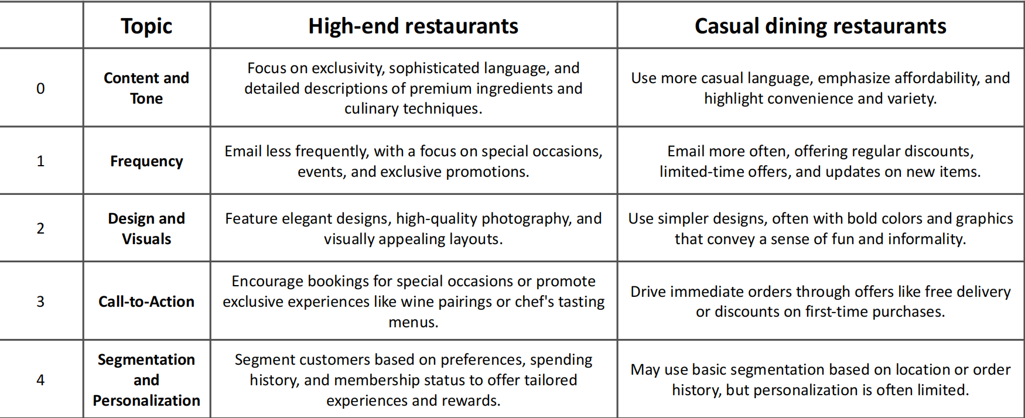
Question 7
Amazon Sales Dataset
The data of 1K+ Amazon Poduct's Ratings and Reviews as per their details listed on the official website of Amazon with 16 features as following:
product_id
product_name
category •
discounted_price
actual_price •
discount_percentage
rating•
rating_count
about_product
user_id•
user_name•
review_id
review_title•
review_content•
img_link•
product_link
| 3

Slide 18
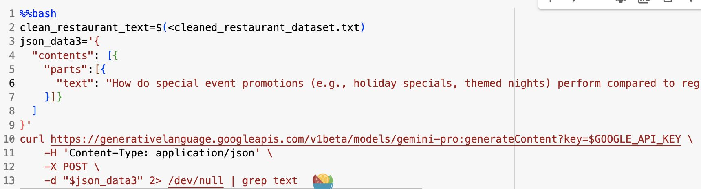
Question 8
8. How do special event promotions perform compared to regular promotions?
Amazon Sales Dataset
The data of 1K+ Amazon Product's Ratings and Reviews as per their details listed on the official website of Amazon with 16 features as following:
product_id
product_name
category •
discounted_price
actual_price •
discount_percentage
rating•
rating_count
about_product
user_id•
user_name•
review_id
review_title•
review_content•
img_link•
product_link
| 3

Slide 19
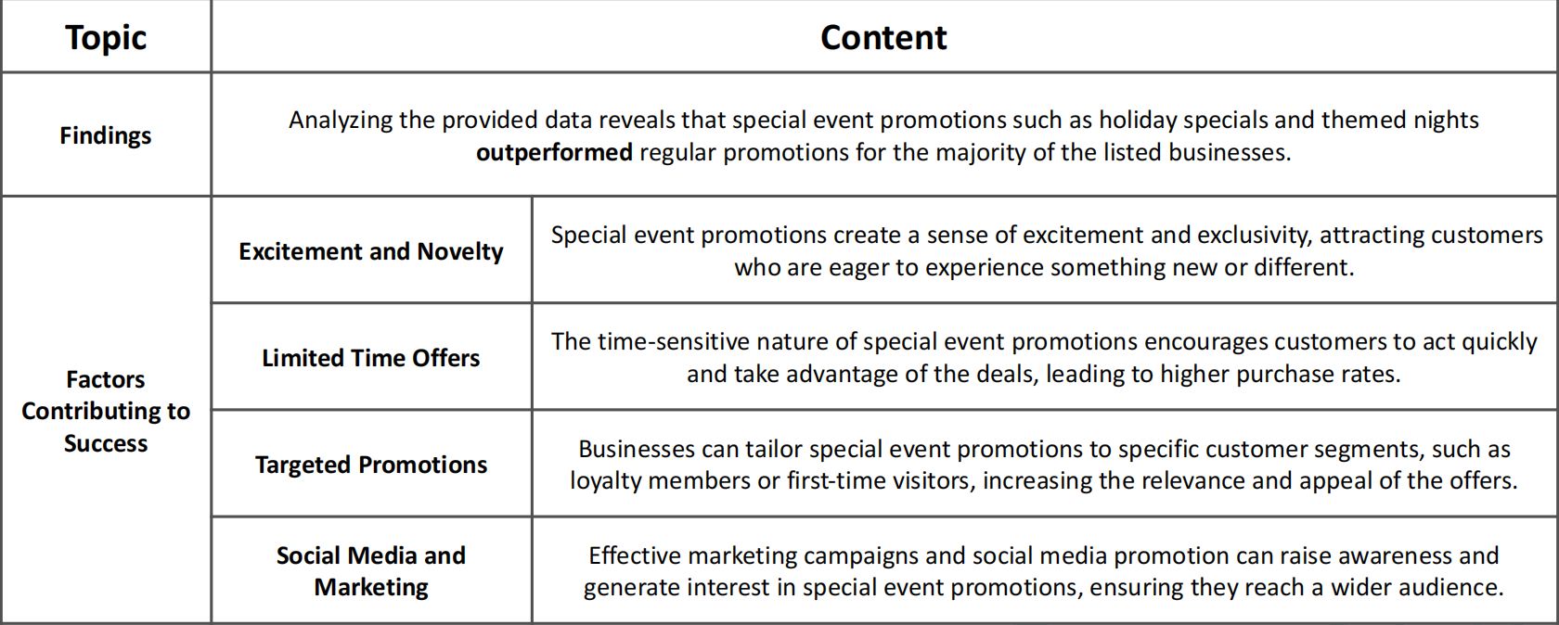
Question 8
Amazon Sales Dataset
The data of 1K+ Amazon Poduct's Ratings and Reviews as per their details listed on the official website of Amazon with 16 features as following:
product_id
product_name
category •
discounted_price
actual_price •
discount_percentage
rating•
rating_count
about_product
user_id•
user_name•
review_id
review_title•
review_content•
img_link•
product_link
| 3

Slide 20
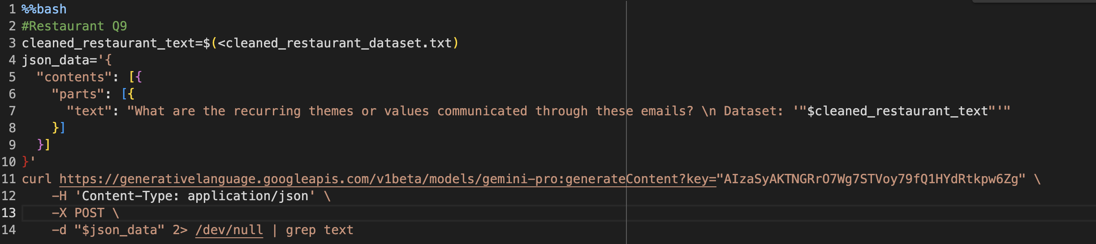
Question 9
9. What are the recurring themes or values communicated through these emails?
Amazon Sales Dataset
The data of 1K+ Amazon Product's Ratings and Reviews as per their details listed on the official website of Amazon with 16 features as following:
product_id
product_name
category •
discounted_price
actual_price •
discount_percentage
rating•
rating_count
about_product
user_id•
user_name•
review_id
review_title•
review_content•
img_link•
product_link
| 3

Slide 21
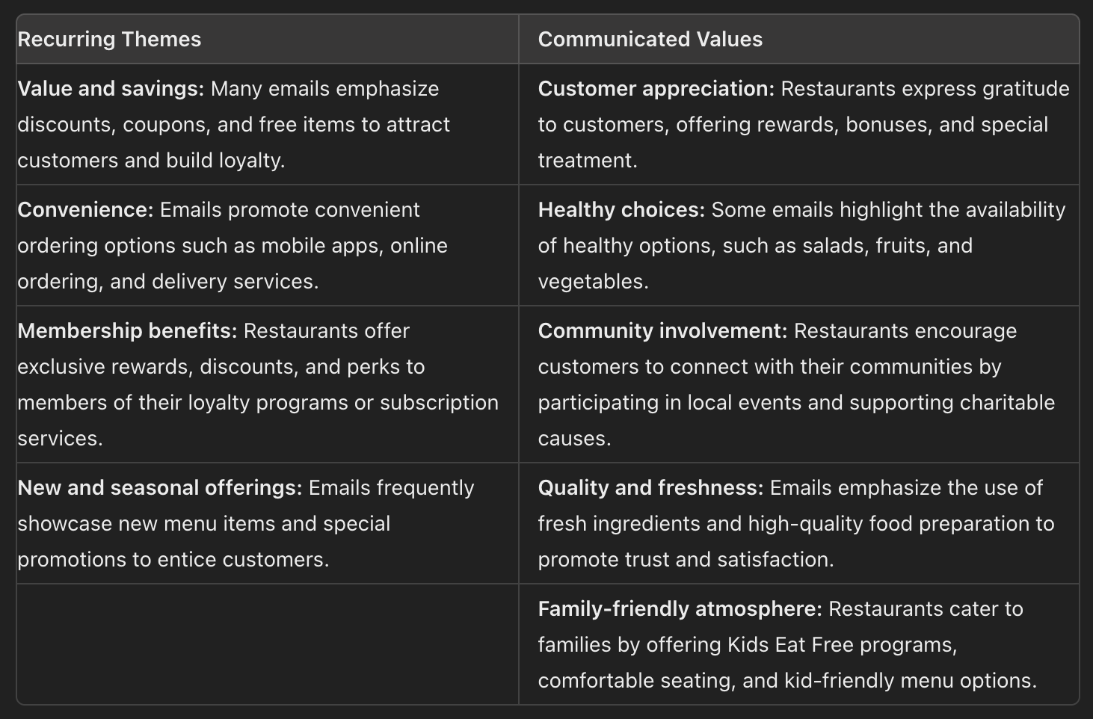
Question 9
Amazon Sales Dataset
The data of 1K+ Amazon Poduct's Ratings and Reviews as per their details listed on the official website of Amazon with 16 features as following:
Sure, here is the information organized in a table format:
| **Recurring Themes** | **Communicated Values** |
|----------------------|--------------------------|
| **Value and savings:** Many emails emphasize discounts, coupons, and free items to attract customers and build loyalty. | **Customer appreciation:** Restaurants express gratitude to customers, offering rewards, bonuses, and special treatment. |
| **Convenience:** Emails promote convenient ordering options such as mobile apps, online ordering, and delivery services. | **Healthy choices:** Some emails highlight the availability of healthy options, such as salads, fruits, and vegetables. |
| **Membership benefits:** Restaurants offer exclusive rewards, discounts, and perks to members of their loyalty programs or subscription services. | **Community involvement:** Restaurants encourage customers to connect with their communities by participating in local events and supporting charitable causes. |
| **New and seasonal offerings:** Emails frequently showcase new menu items and special promotions to entice customers. | **Quality and freshness:** Emails emphasize the use of fresh ingredients and high-quality food preparation to promote trust and satisfaction. |
| | **Family-friendly atmosphere:** Restaurants cater to families by offering Kids Eat Free programs, comfortable seating, and kid-friendly menu options. |
product_id
product_name
category •
discounted_price
actual_price •
discount_percentage
rating•
rating_count
about_product
user_id•
user_name•
review_id
review_title•
review_content•
img_link•
product_link
| 3

Slide 22
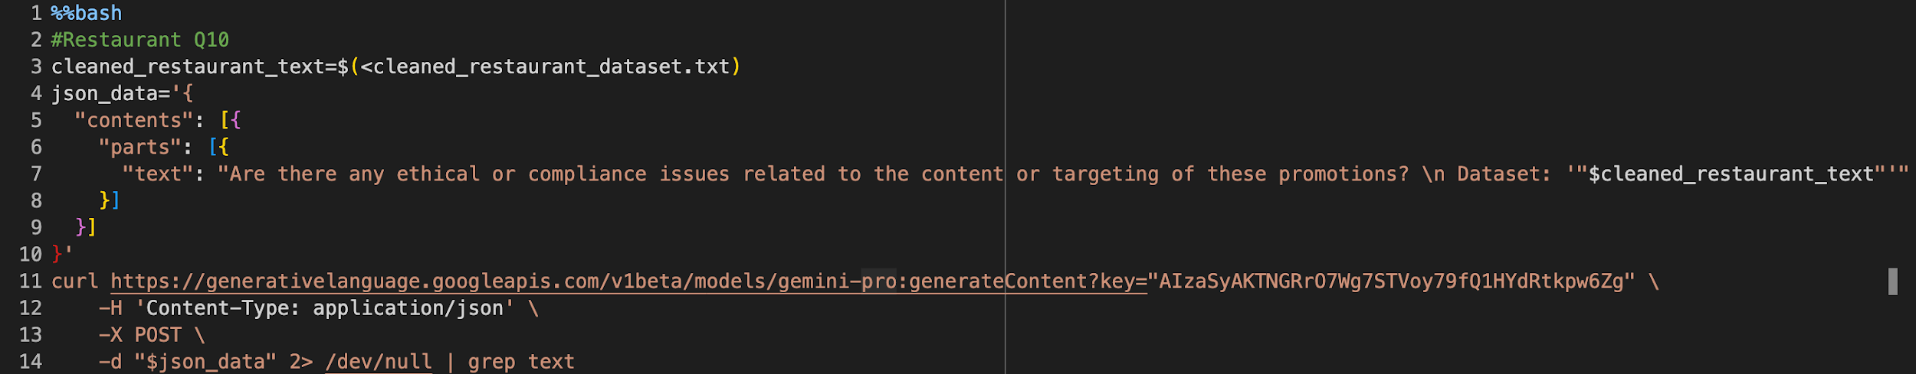
Question 10
10. Are there any ethical or compliance issues related to the content or targeting of these promotions?
Amazon Sales Dataset
The data of 1K+ Amazon Product's Ratings and Reviews as per their details listed on the official website of Amazon with 16 features as following:
product_id
product_name
category •
discounted_price
actual_price •
discount_percentage
rating•
rating_count
about_product
user_id•
user_name•
review_id
review_title•
review_content•
img_link•
product_link
| 3

Slide 23
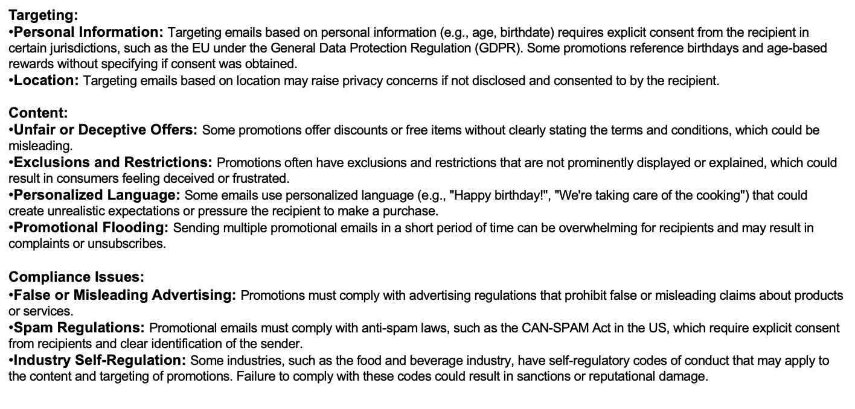
Question 10
Amazon Sales Dataset
The data of 1K+ Amazon Poduct's Ratings and Reviews as per their details listed on the official website of Amazon with 16 features as following:
product_id
product_name
category •
discounted_price
actual_price •
discount_percentage
rating•
rating_count
about_product
user_id•
user_name•
review_id
review_title•
review_content•
img_link•
product_link
| 3

Slide 24
Retail

Slide 25
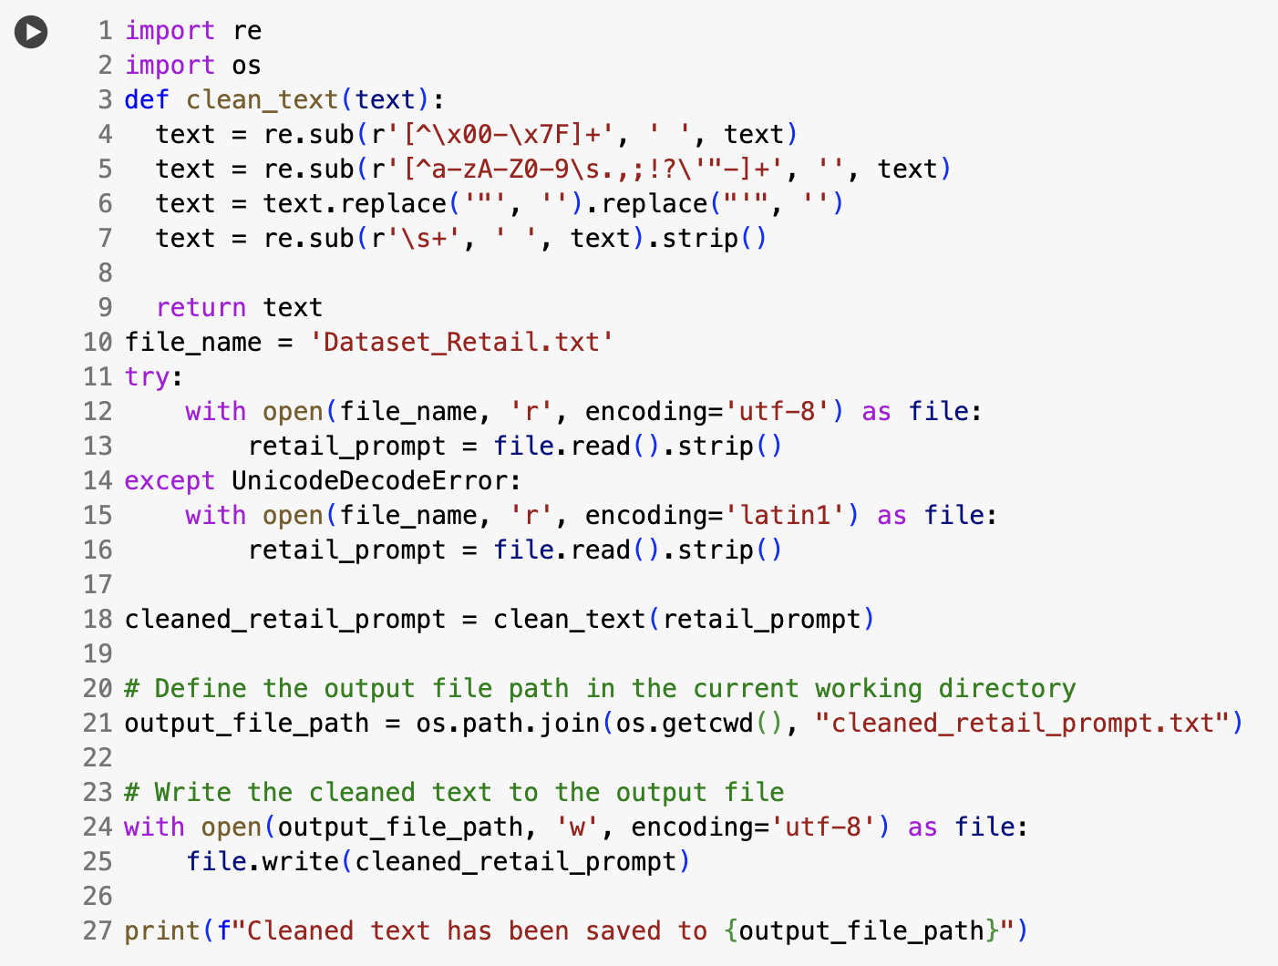
P
Set up for Retail Qs
Amazon Sales Dataset
The data of 1K+ Amazon Product's Ratings and Reviews as per their details listed on the official website of Amazon with 16 features as following:
product_id
product_name
category •
discounted_price
actual_price •
discount_percentage
rating•
rating_count
about_product
user_id•
user_name•
review_id
review_title•
review_content•
img_link•
product_link
| 3

Slide 26
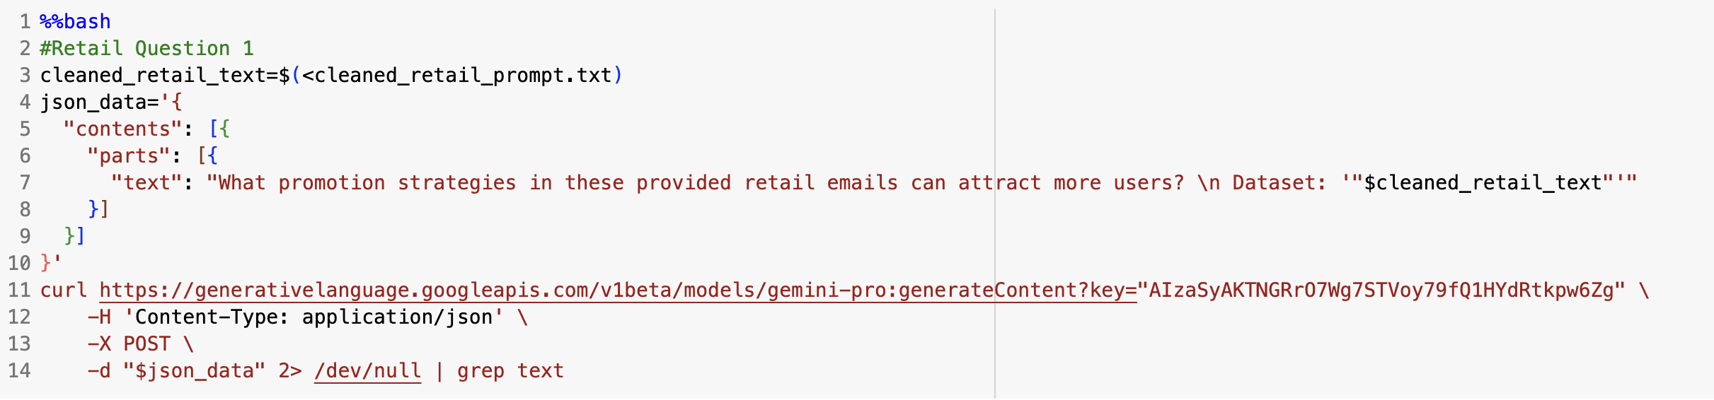
Question 1
1. What promotion strategies in these retail emails that can attract
more users?
Amazon Sales Dataset
The data of 1K+ Amazon Product's Ratings and Reviews as per their details listed on the official website of Amazon with 16 features as following:
product_id
product_name
category •
discounted_price
actual_price •
discount_percentage
rating•
rating_count
about_product
user_id•
user_name•
review_id
review_title•
review_content•
img_link•
product_link
| 3

Slide 27
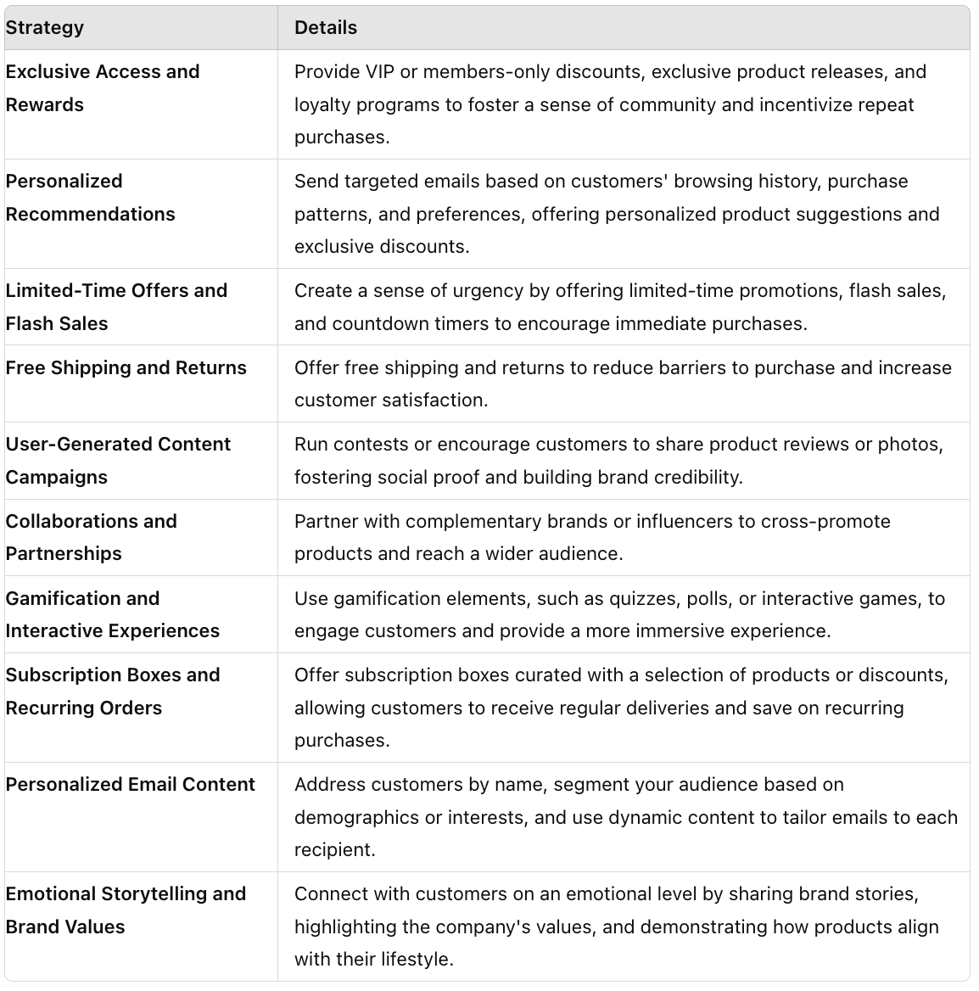
Question 1
Amazon Sales Dataset
The data of 1K+ Amazon Product's Ratings and Reviews as per their details listed on the official website of Amazon with 16 features as following:
product_id
product_name
category •
discounted_price
actual_price •
discount_percentage
rating•
rating_count
about_product
user_id•
user_name•
review_id
review_title•
review_content•
img_link•
product_link
| 3

Slide 28
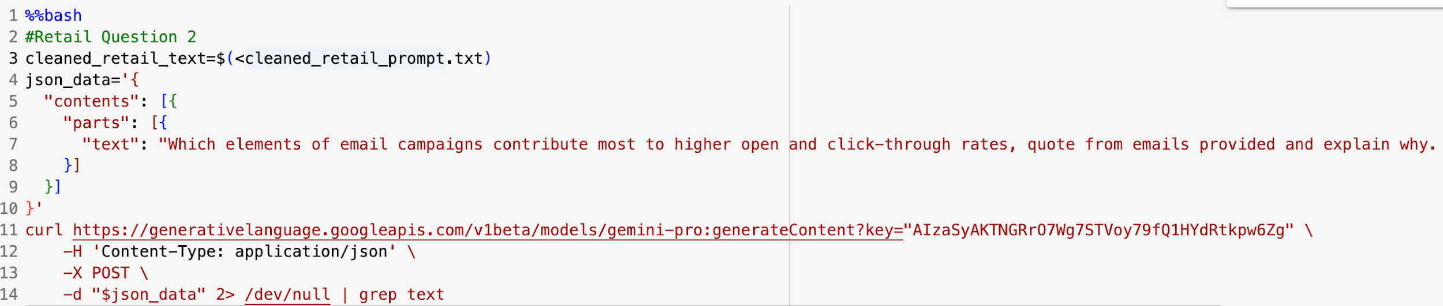
Question 2
2. Which elements of email campaigns contribute most to higher open and
click-through rates?
Amazon Sales Dataset
The data of 1K+ Amazon Product's Ratings and Reviews as per their details listed on the official website of Amazon with 16 features as following:
product_id
product_name
category •
discounted_price
actual_price •
discount_percentage
rating•
rating_count
about_product
user_id•
user_name•
review_id
review_title•
review_content•
img_link•
product_link
| 3

Slide 29
Question 2
Summary:
They employ urgency and exclusivity, such as "Final chance for our VIPs EXTRA 30 OFF," to create a sense of importance and prompt immediate action.
Other lines introduce new products like "Introducing The Cow Print Collection," highlight specific offers such as "30% off, today only!" or "Free shipping and returns," and use playful or descriptive language to appeal to customers' emotions and interests.
Techniques like personalized content, limited-time deals, and vivid descriptions of new arrivals or special promotions help increase open rates and encourage clicks. For example, "Spring accessories starting at $10 take an extra 40% off sale styles" offers a clear discount, while "Knock knock It's your new spring favorites!" uses a conversational tone to engage readers.
Overall, these subject lines effectively combine urgency, exclusivity, and appealing offers to attract customers and drive sales.
Amazon Sales Dataset
The data of 1K+ Amazon Product's Ratings and Reviews as per their details listed on the official website of Amazon with 16 features as following:
product_id
product_name
category •
discounted_price
actual_price •
discount_percentage
rating•
rating_count
about_product
user_id•
user_name•
review_id
review_title•
review_content•
img_link•
product_link
| 3

Slide 30
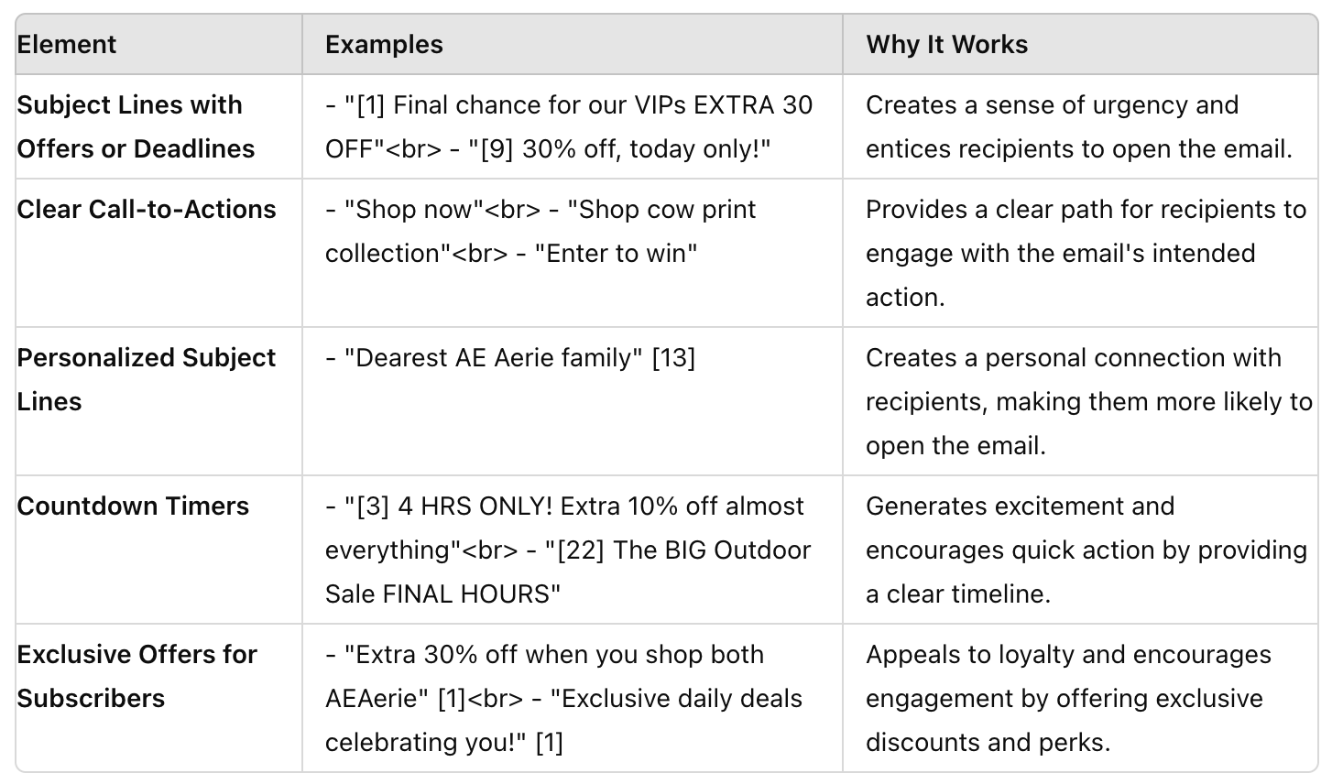
Question 2
Amazon Sales Dataset
The data of 1K+ Amazon Product's Ratings and Reviews as per their details listed on the official website of Amazon with 16 features as following:
product_id
product_name
category •
discounted_price
actual_price •
discount_percentage
rating•
rating_count
about_product
user_id•
user_name•
review_id
review_title•
review_content•
img_link•
product_link
| 3

Slide 31
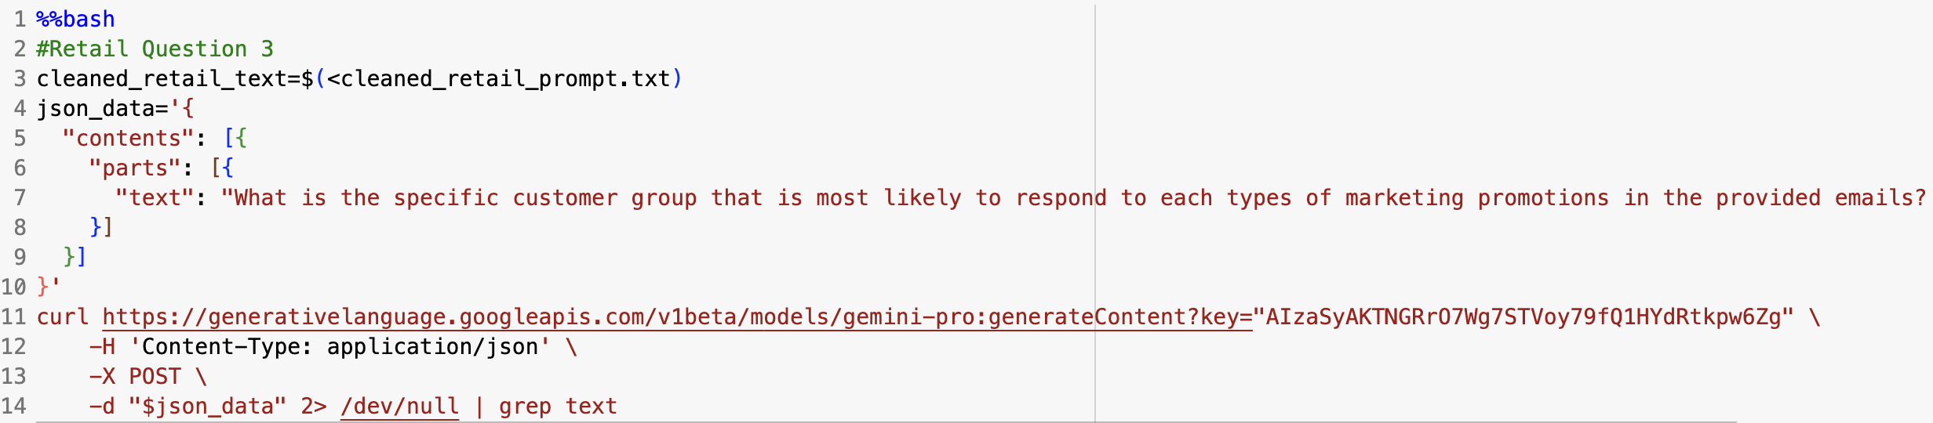
Question 3
3. Are there some specific customer group that is more likely to respond
to certain types of marketing promotions?
Amazon Sales Dataset
The data of 1K+ Amazon Product's Ratings and Reviews as per their details listed on the official website of Amazon with 16 features as following:
product_id
product_name
category •
discounted_price
actual_price •
discount_percentage
rating•
rating_count
about_product
user_id•
user_name•
review_id
review_title•
review_content•
img_link•
product_link
| 3

Slide 32
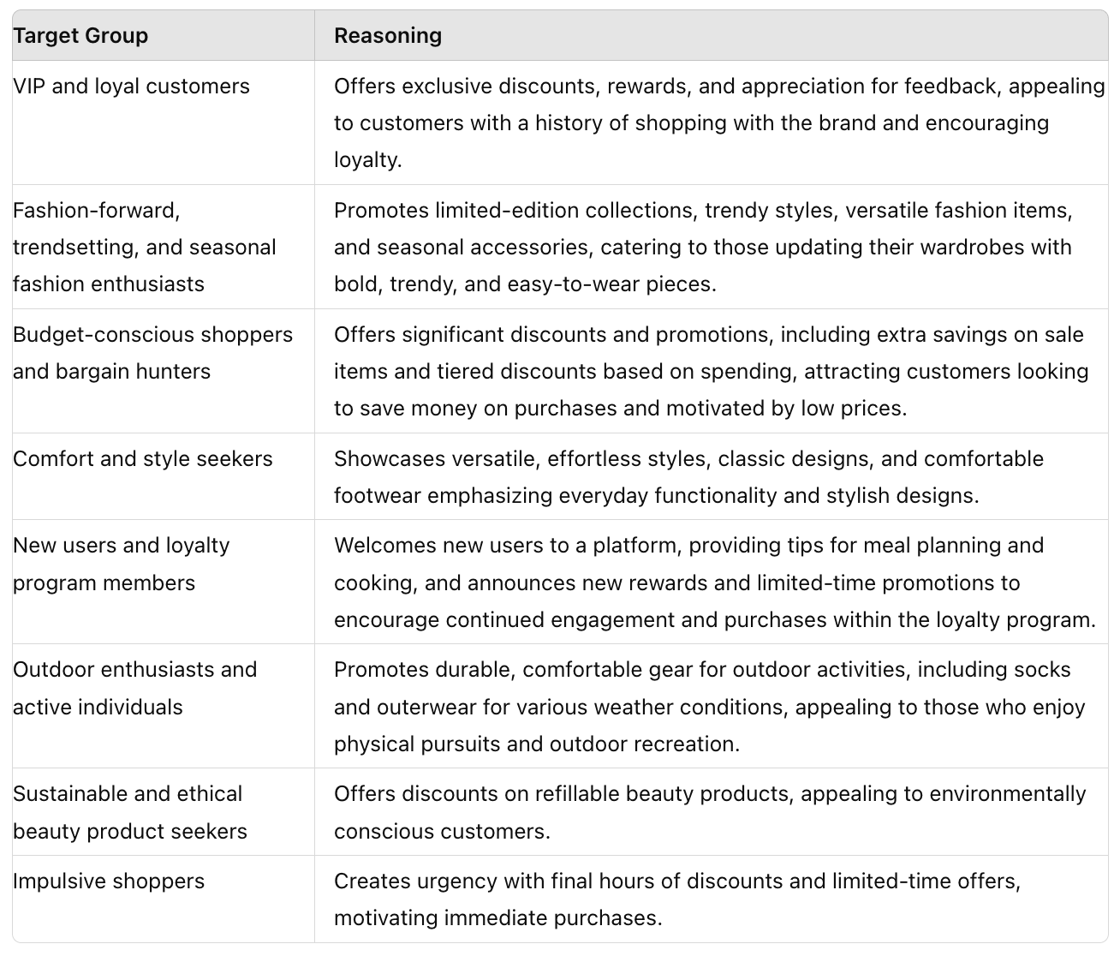
Question 3
Amazon Sales Dataset
The data of 1K+ Amazon Poduct's Ratings and Reviews as per their details listed on the official website of Amazon with 16 features as following:
product_id
product_name
category •
discounted_price
actual_price •
discount_percentage
rating•
rating_count
about_product
user_id•
user_name•
review_id
review_title•
review_content•
img_link•
product_link
| 3

Slide 33
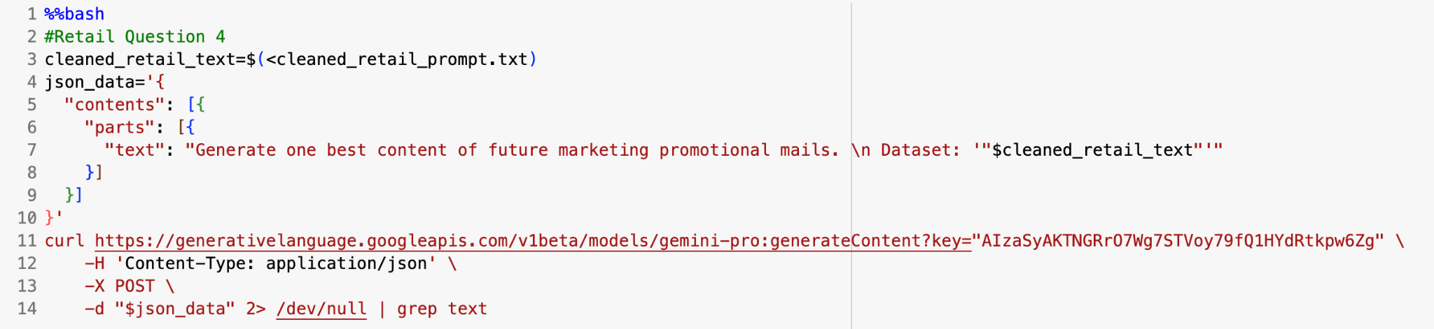
Question 4
4. Generate the best content of future marketing promotional mails
Amazon Sales Dataset
The data of 1K+ Amazon Product's Ratings and Reviews as per their details listed on the official website of Amazon with 16 features as following:
product_id
product_name
category •
discounted_price
actual_price •
discount_percentage
rating•
rating_count
about_product
user_id•
user_name•
review_id
review_title•
review_content•
img_link•
product_link
| 3

Slide 34
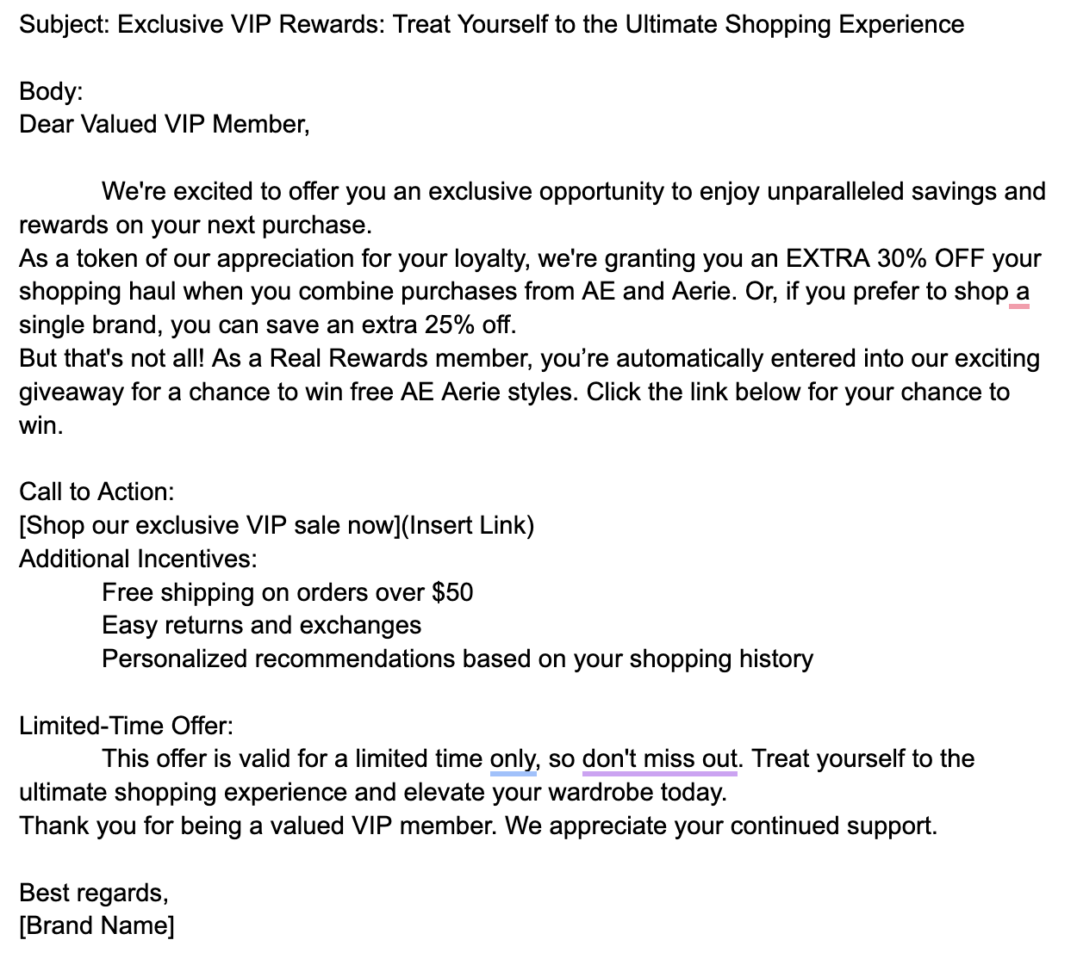
Question 4
Amazon Sales Dataset
The data of 1K+ Amazon Product's Ratings and Reviews as per their details listed on the official website of Amazon with 16 features as following:
product_id
product_name
category •
discounted_price
actual_price •
discount_percentage
rating•
rating_count
about_product
user_id•
user_name•
review_id
review_title•
review_content•
img_link•
product_link
| 3

Slide 35
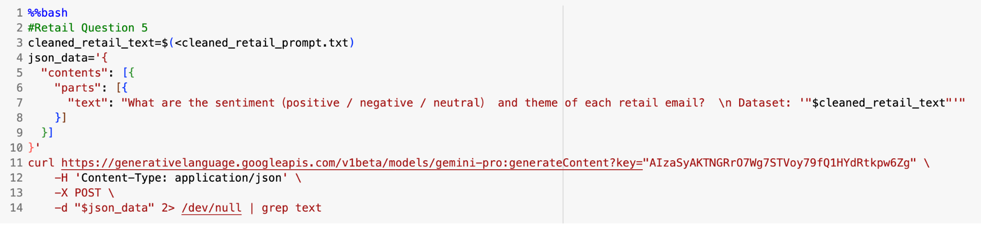
Question 5
5. What are the sentiment and the theme of retail emails?
Amazon Sales Dataset
The data of 1K+ Amazon Product's Ratings and Reviews as per their details listed on the official website of Amazon with 16 features as following:
product_id
product_name
category •
discounted_price
actual_price •
discount_percentage
rating•
rating_count
about_product
user_id•
user_name•
review_id
review_title•
review_content•
img_link•
product_link
| 3

Slide 36
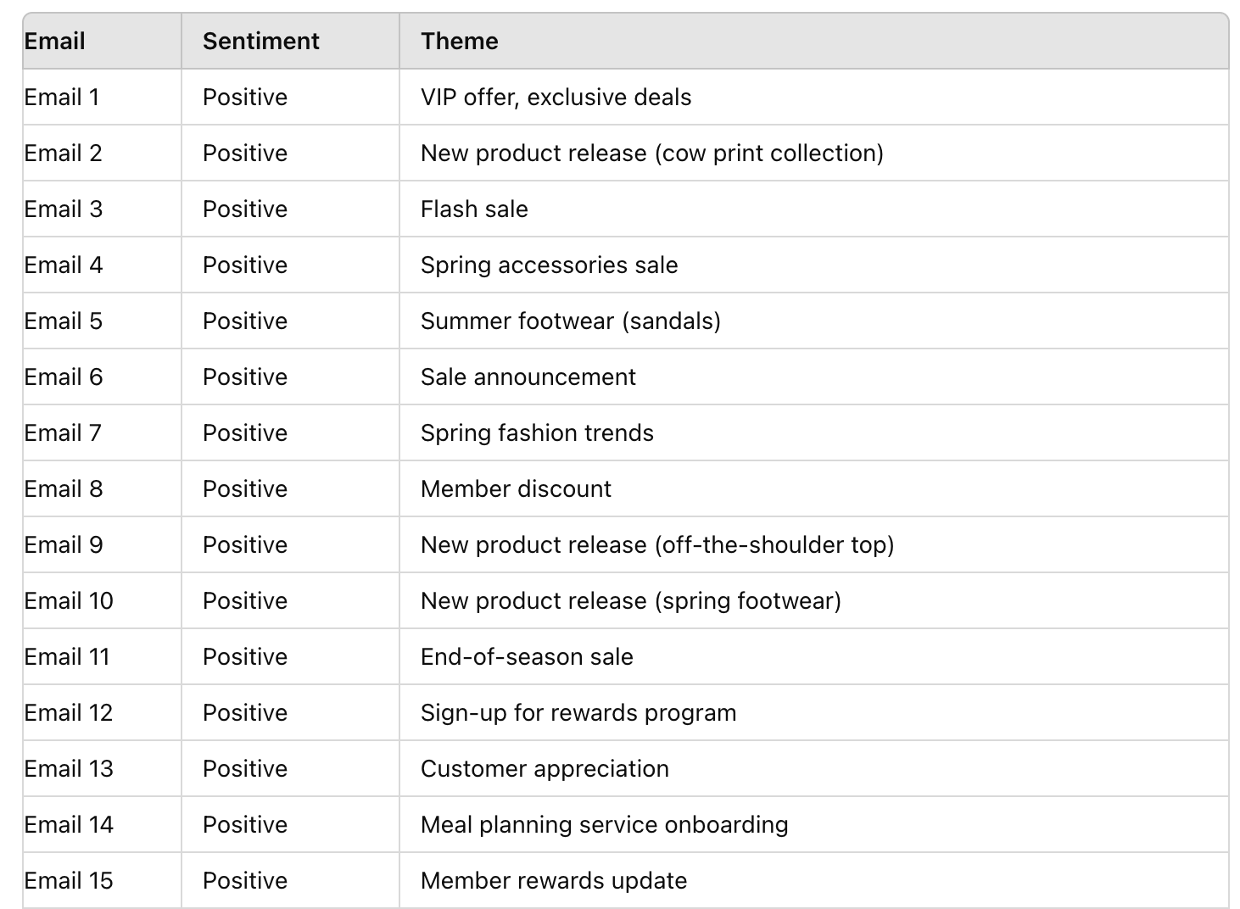
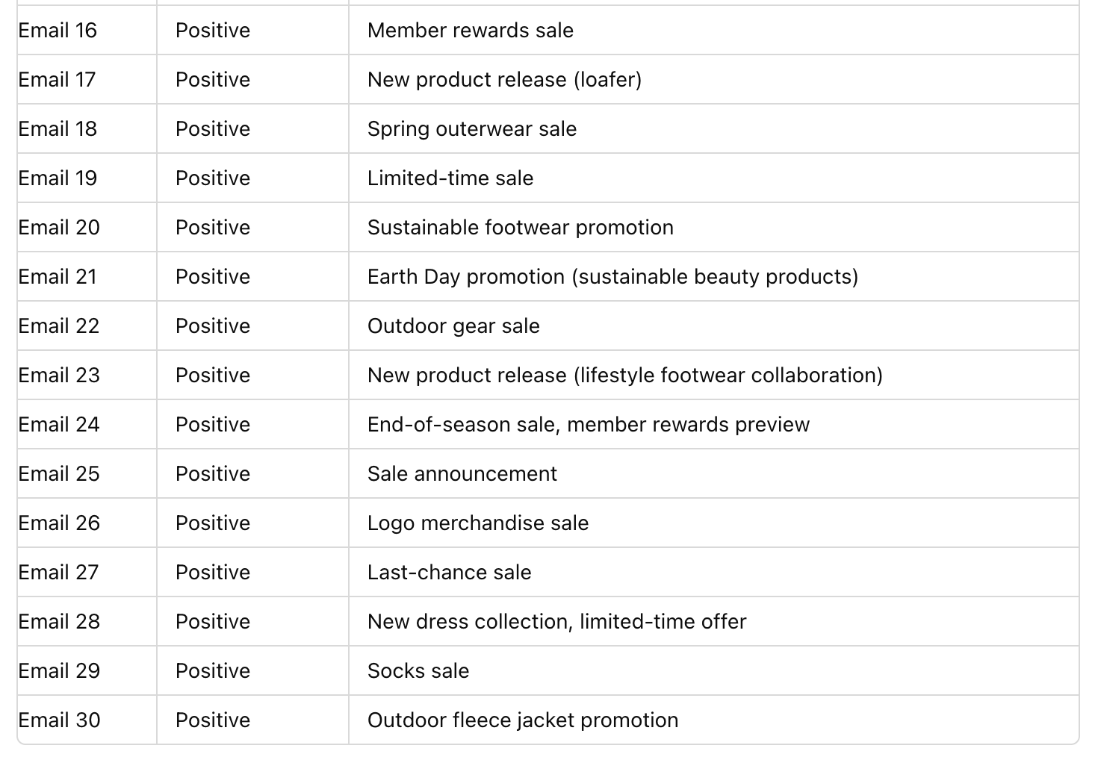
Question 5
Amazon Sales Dataset
The data of 1K+ Amazon Poduct's Ratings and Reviews as per their details listed on the official website of Amazon with 16 features as following:
product_id
product_name
category •
discounted_price
actual_price •
discount_percentage
ratin
rating_count
about_product
user_id•
user_name•
review_id
P
-P
img_link•
product_link
Positive > Negative
(All Positive)
| 3

Slide 37
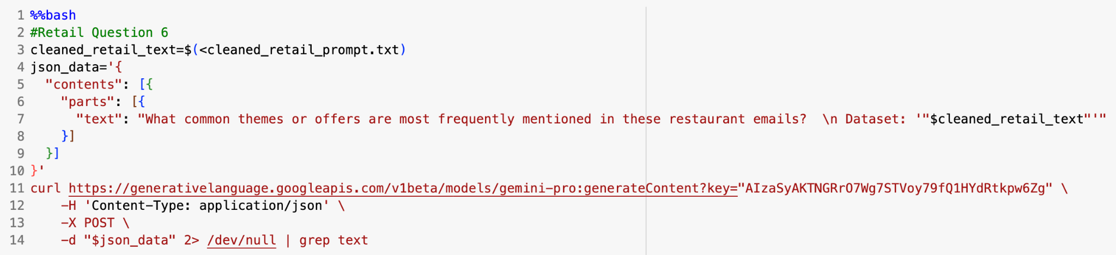
Question 6
6. What common themes or offers are most frequently mentioned in these retail
emails?
Amazon Sales Dataset
The data of 1K+ Amazon Product's Ratings and Reviews as per their details listed on the official website of Amazon with 16 features as following:
product_id
product_name
category •
discounted_price
actual_price •
discount_percentage
rating•
rating_count
about_product
user_id•
user_name•
review_id
review_title•
review_content•
img_link•
product_link
| 3

Slide 38
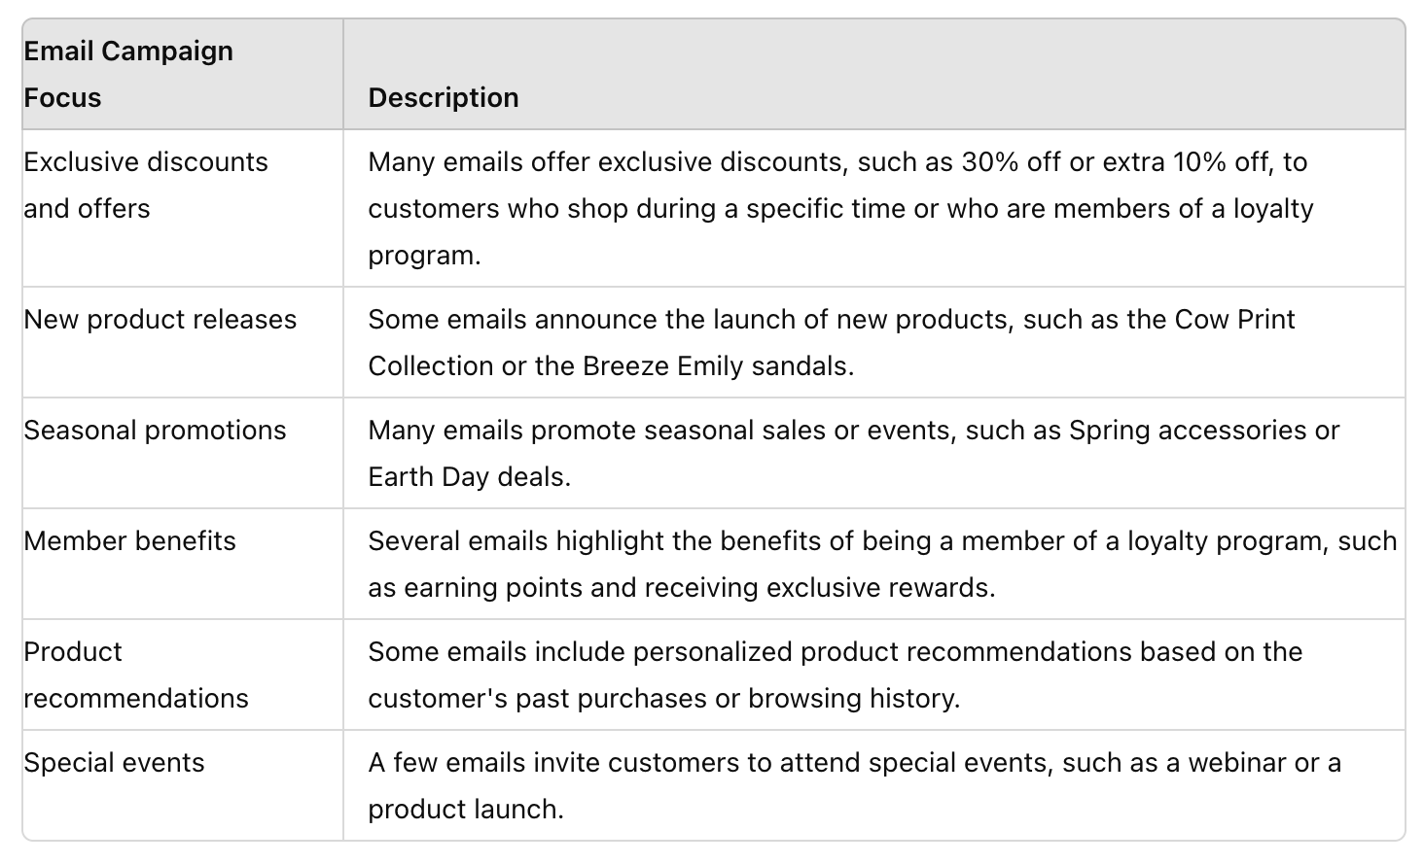
Question 6
Amazon Sales Dataset
The data of 1K+ Amazon Poduct's Ratings and Reviews as per their details listed on the official website of Amazon with 16 features as following:
product_id
product_name
category •
discounted_price
actual_price •
discount_percentage
rating•
rating_count
about_product
user_id•
user_name•
review_id
review_title•
review_content•
img_link•
product_link
| 3

Slide 39
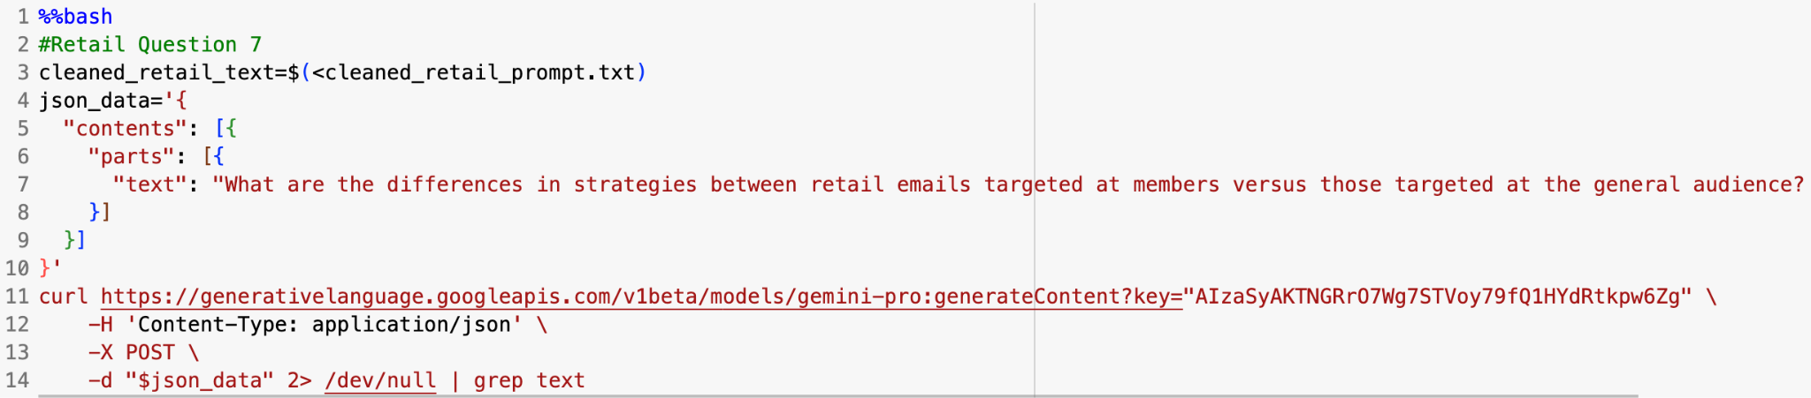
Question 7
7. What are the differences in strategies between retail emails targeted at members versus those targeted at the general audience?
Amazon Sales Dataset
The data of 1K+ Amazon Product's Ratings and Reviews as per their details listed on the official website of Amazon with 16 features as following:
product_id
product_name
category •
discounted_price
actual_price •
discount_percentage
rating•
rating_count
about_product
user_id•
user_name•
review_id
review_title•
review_content•
img_link•
product_link
| 3

Slide 40
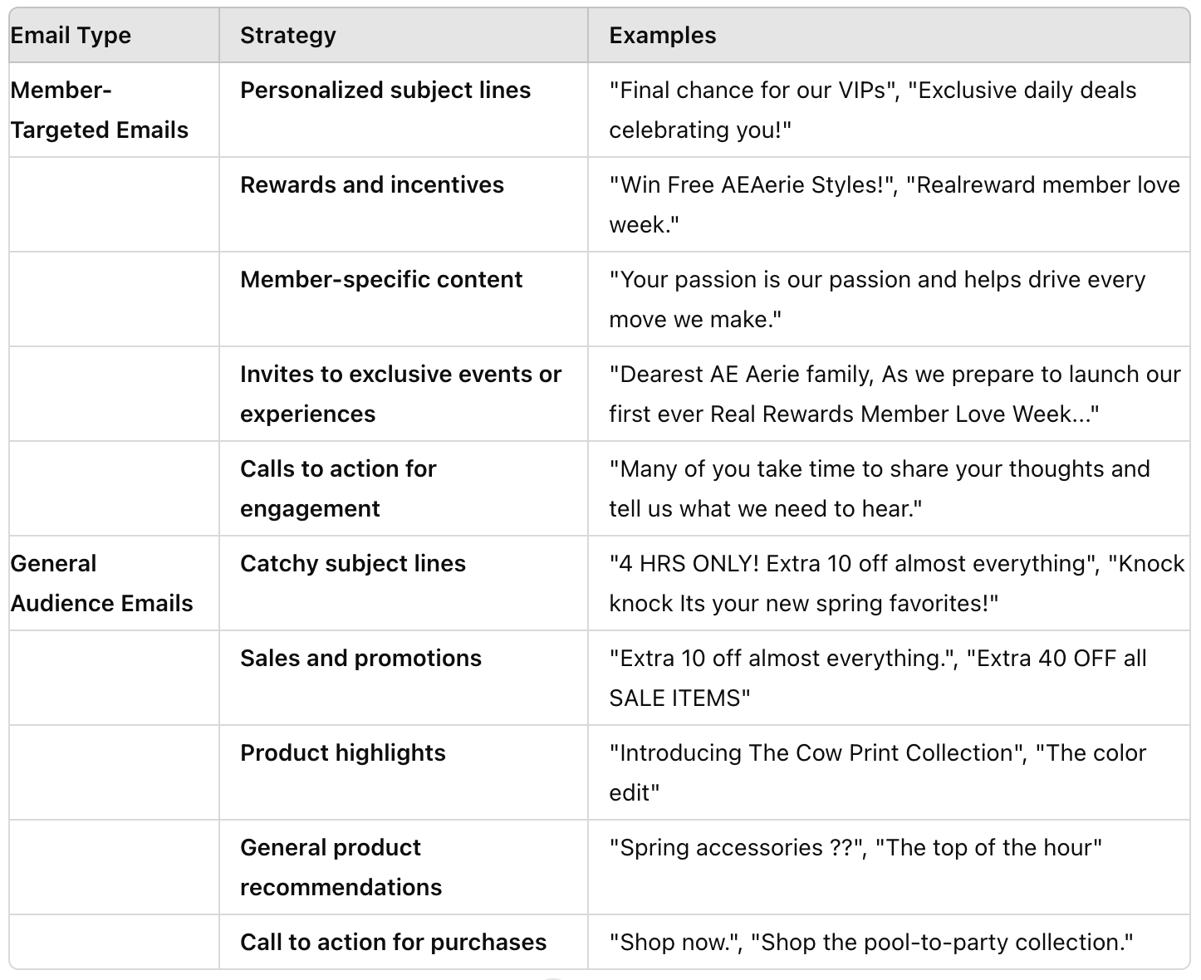
Question 7
Amazon Sales Dataset
The data of 1K+ Amazon Poduct's Ratings and Reviews as per their details listed on the official website of Amazon with 16 features as following:
product_id
product_name
category •
discounted_price
actual_price •
discount_percentage
rating•
rating_count
about_product
user_id•
user_name•
review_id
review_title•
review_content•
img_link•
product_link
| 3

Slide 41
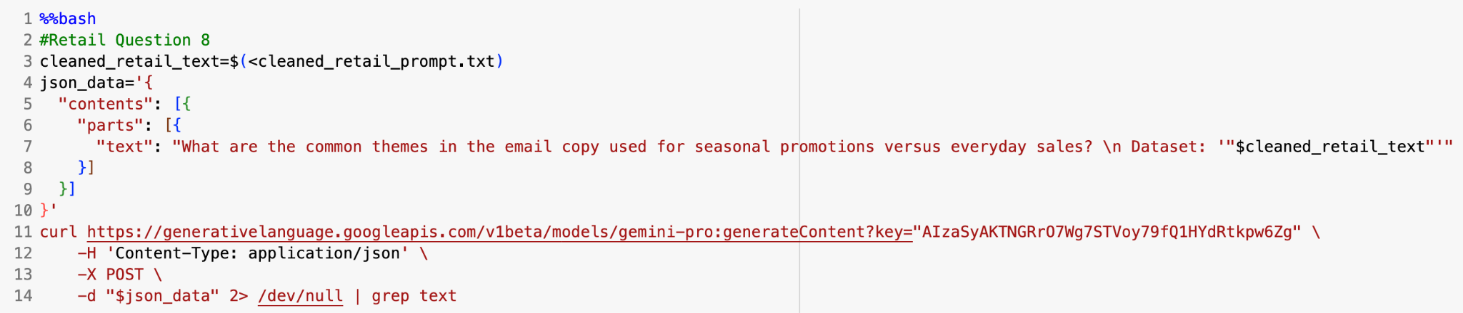
Question 8
8. What are the common themes in the email copy used for seasonal promotions
versus everyday sales?
Amazon Sales Dataset
The data of 1K+ Amazon Product's Ratings and Reviews as per their details listed on the official website of Amazon with 16 features as following:
product_id
product_name
category •
discounted_price
actual_price •
discount_percentage
rating•
rating_count
about_product
user_id•
user_name•
review_id
review_title•
review_content•
img_link•
product_link
| 3

Slide 42
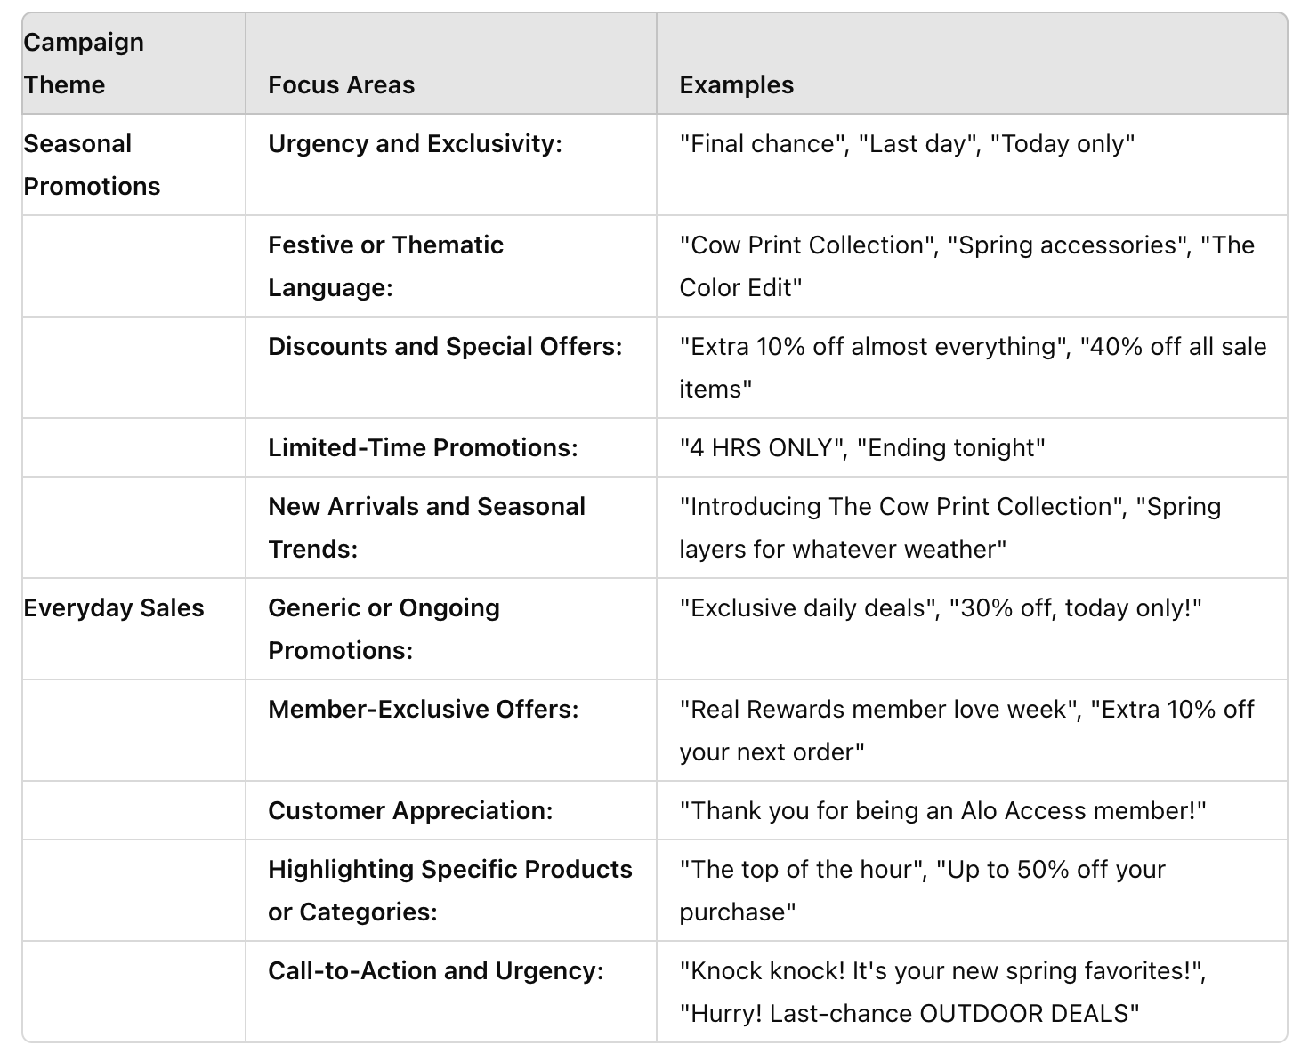
Question 8
Amazon Sales Dataset
The data of 1K+ Amazon Poduct's Ratings and Reviews as per their details listed on the official website of Amazon with 16 features as following:
product_id
product_name
category •
discounted_price
actual_price •
discount_percentage
rating•
rating_count
about_product
user_id•
user_name•
review_id
review_title•
review_content•
img_link•
product_link
| 3

Slide 43
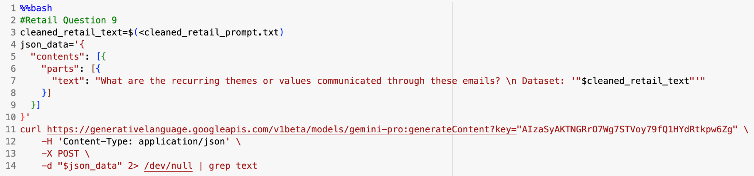
Question 9
9. What are the recurring themes or values communicated through these emails?
Amazon Sales Dataset
The data of 1K+ Amazon Product's Ratings and Reviews as per their details listed on the official website of Amazon with 16 features as following:
product_id
product_name
category •
discounted_price
actual_price •
discount_percentage
rating•
rating_count
about_product
user_id•
user_name•
review_id
review_title•
review_content•
img_link•
product_link
| 3

Slide 44
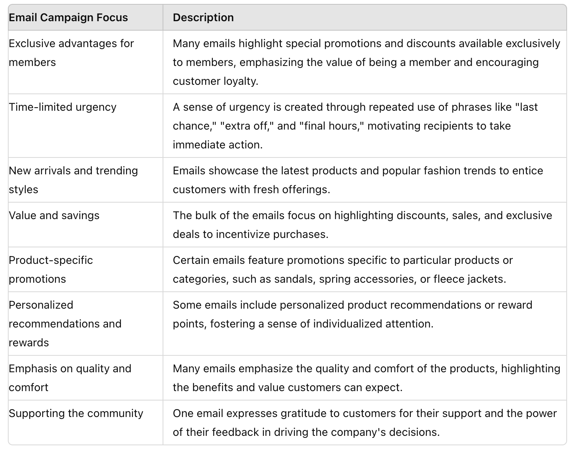
Question 9
Amazon Sales Dataset
The data of 1K+ Amazon Poduct's Ratings and Reviews as per their details listed on the official website of Amazon with 16 features as following:
Sure, here is the information organized in a table format:
| **Recurring Themes** | **Communicated Values** |
|----------------------|--------------------------|
| **Value and savings:** Many emails emphasize discounts, coupons, and free items to attract customers and build loyalty. | **Customer appreciation:** Restaurants express gratitude to customers, offering rewards, bonuses, and special treatment. |
| **Convenience:** Emails promote convenient ordering options such as mobile apps, online ordering, and delivery services. | **Healthy choices:** Some emails highlight the availability of healthy options, such as salads, fruits, and vegetables. |
| **Membership benefits:** Restaurants offer exclusive rewards, discounts, and perks to members of their loyalty programs or subscription services. | **Community involvement:** Restaurants encourage customers to connect with their communities by participating in local events and supporting charitable causes. |
| **New and seasonal offerings:** Emails frequently showcase new menu items and special promotions to entice customers. | **Quality and freshness:** Emails emphasize the use of fresh ingredients and high-quality food preparation to promote trust and satisfaction. |
| | **Family-friendly atmosphere:** Restaurants cater to families by offering Kids Eat Free programs, comfortable seating, and kid-friendly menu options. |
product_id
product_name
category •
discounted_price
actual_price •
discount_percentage
rating•
rating_count
about_product
user_id•
user_name•
review_id
review_title•
review_content•
img_link•
product_link
| 3

Slide 45
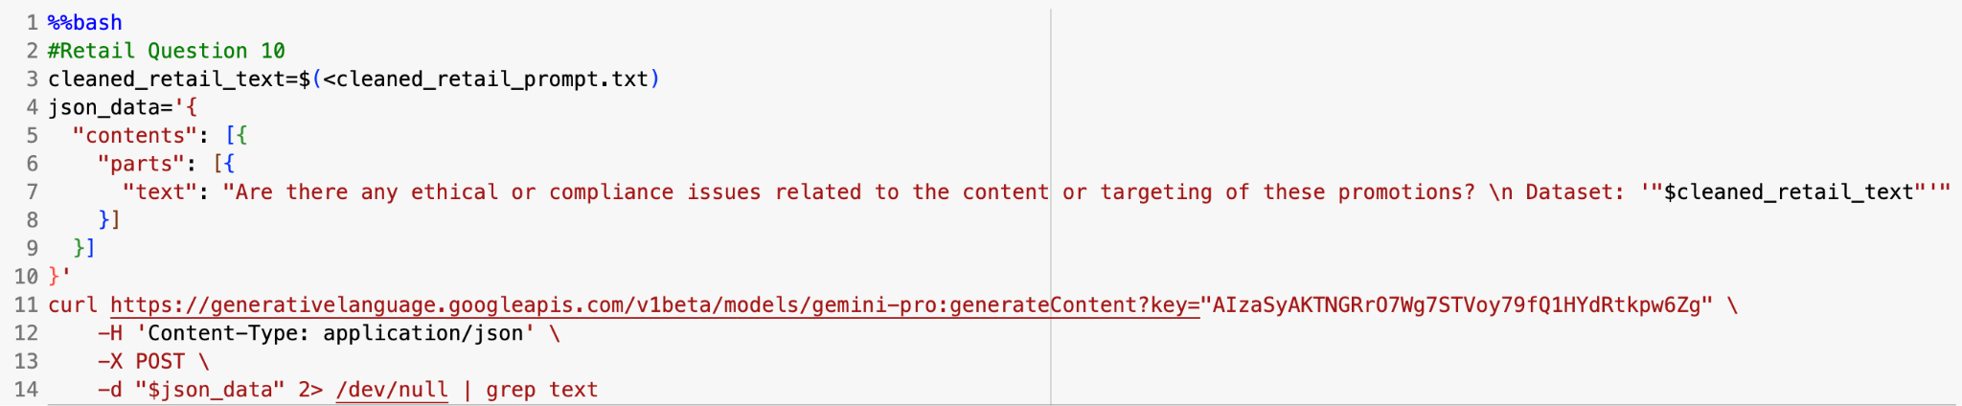
Question 10
10. Are there any ethical or compliance issues related to the content or targeting of
these promotions?
Amazon Sales Dataset
The data of 1K+ Amazon Product's Ratings and Reviews as per their details listed on the official website of Amazon with 16 features as following:
product_id
product_name
category •
discounted_price
actual_price •
discount_percentage
rating•
rating_count
about_product
user_id•
user_name•
review_id
review_title•
review_content•
img_link•
product_link
| 3

Slide 46
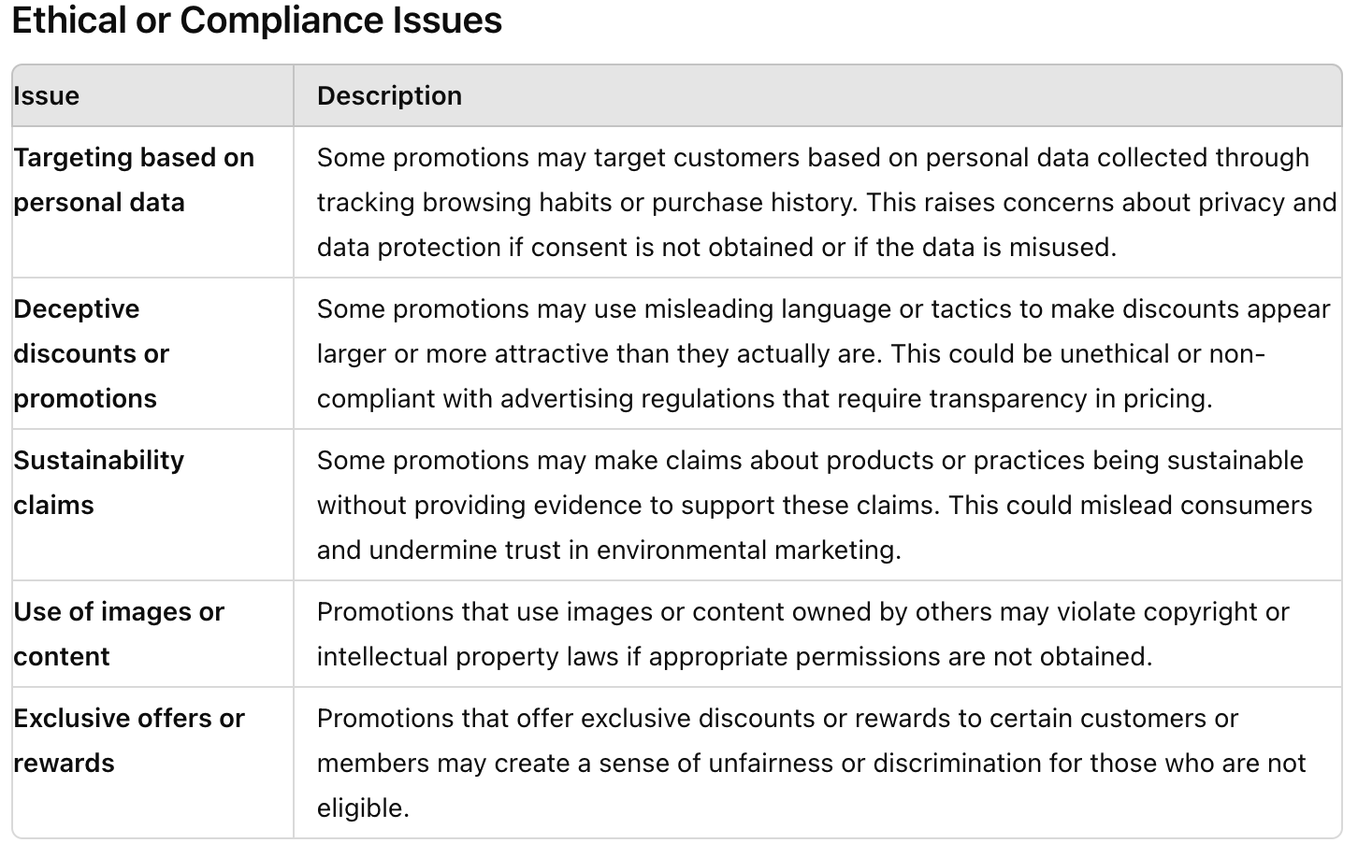
Question 10
Amazon Sales Dataset
The data of 1K+ Amazon Poduct's Ratings and Reviews as per their details listed on the official website of Amazon with 16 features as following:
product_id
product_name
category •
discounted_price
actual_price •
discount_percentage
rating•
rating_count
about_product
user_id•
user_name•
review_id
review_title•
review_content•
img_link•
product_link
| 3

Slide 47
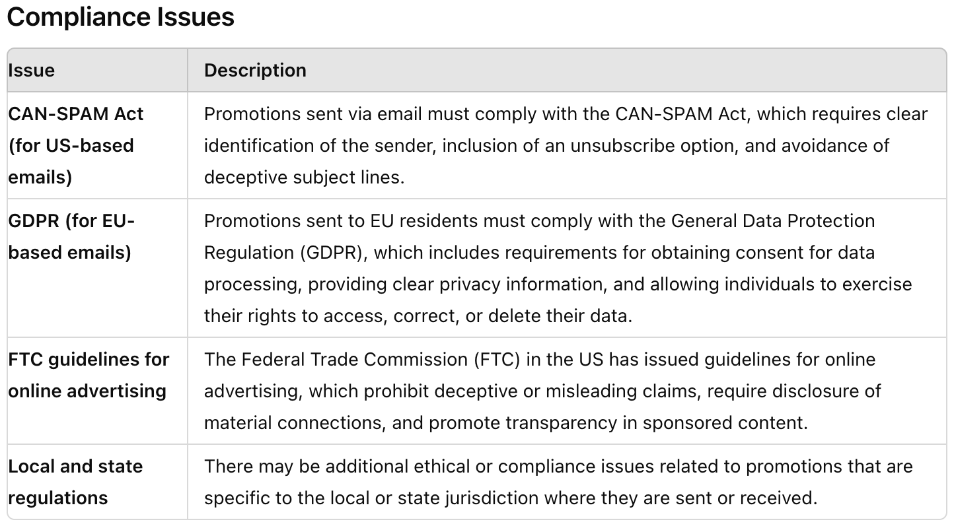
Question 10
Amazon Sales Dataset
The data of 1K+ Amazon Poduct's Ratings and Reviews as per their details listed on the official website of Amazon with 16 features as following:
product_id
product_name
category •
discounted_price
actual_price •
discount_percentage
rating•
rating_count
about_product
user_id•
user_name•
review_id
review_title•
review_content•
img_link•
product_link
| 3

Slide 48
University

Slide 49
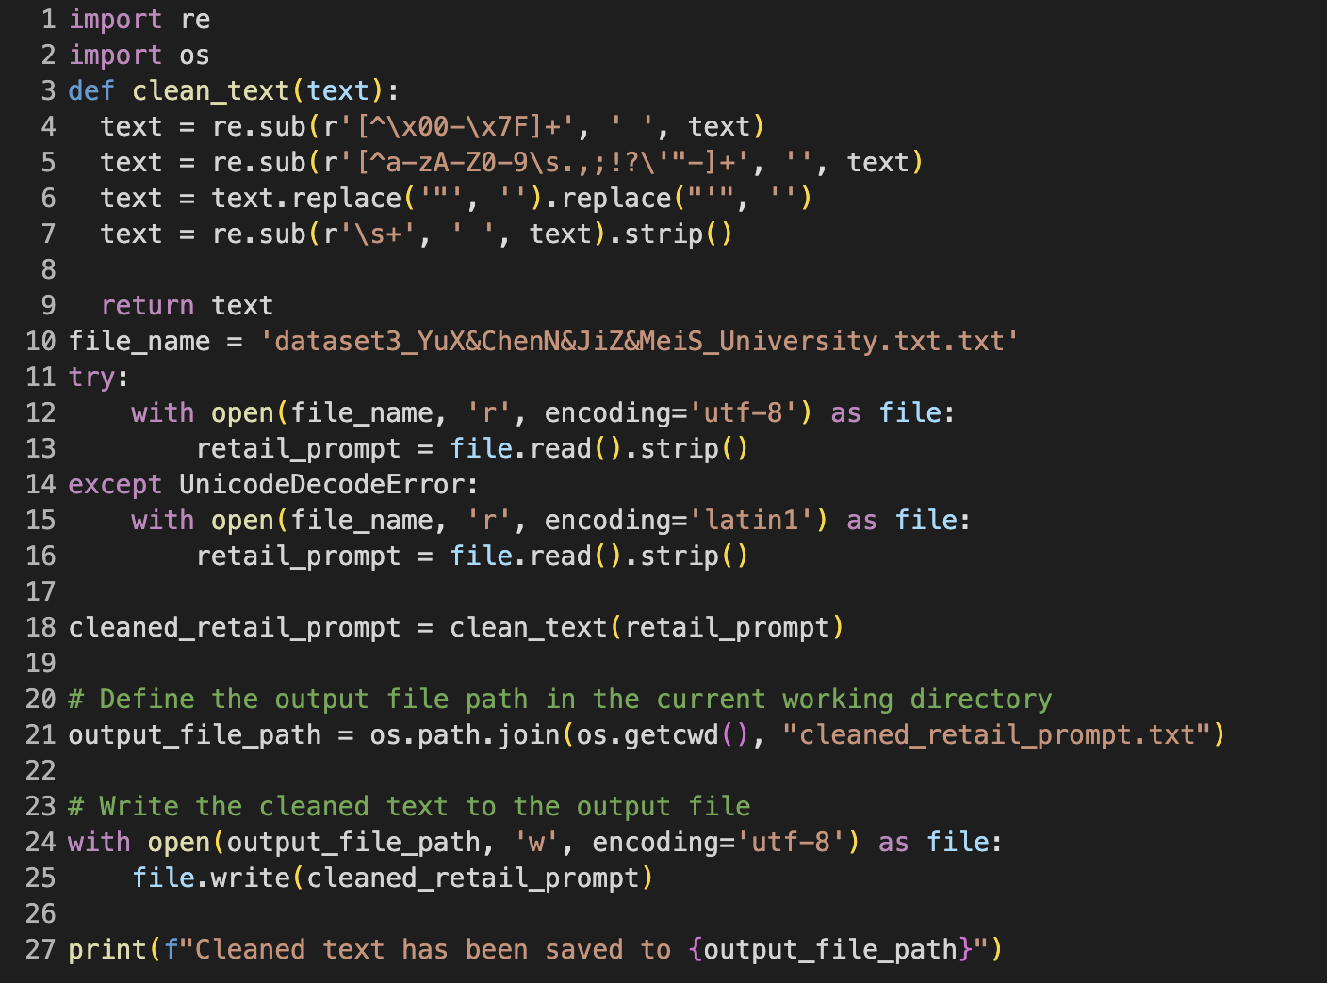
P
Set up for University Qs
Amazon Sales Dataset
The data of 1K+ Amazon Product's Ratings and Reviews as per their details listed on the official website of Amazon with 16 features as following:
product_id
product_name
category •
discounted_price
actual_price •
discount_percentage
rating•
rating_count
about_product
user_id•
user_name•
review_id
review_title•
review_content•
img_link•
product_link
| 3

Slide 50
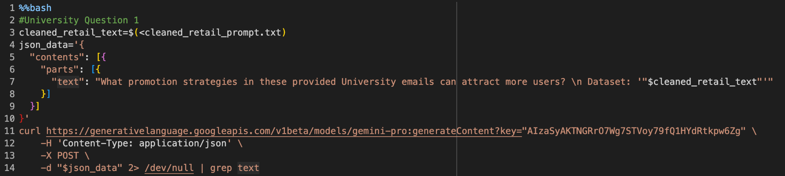
Question 1
1. What promotion strategies in these University emails that can attract
more users?
Amazon Sales Dataset
The data of 1K+ Amazon Product's Ratings and Reviews as per their details listed on the official website of Amazon with 16 features as following:
product_id
product_name
category •
discounted_price
actual_price •
discount_percentage
rating•
rating_count
about_product
user_id•
user_name•
review_id
review_title•
review_content•
img_link•
product_link
| 3

Slide 51
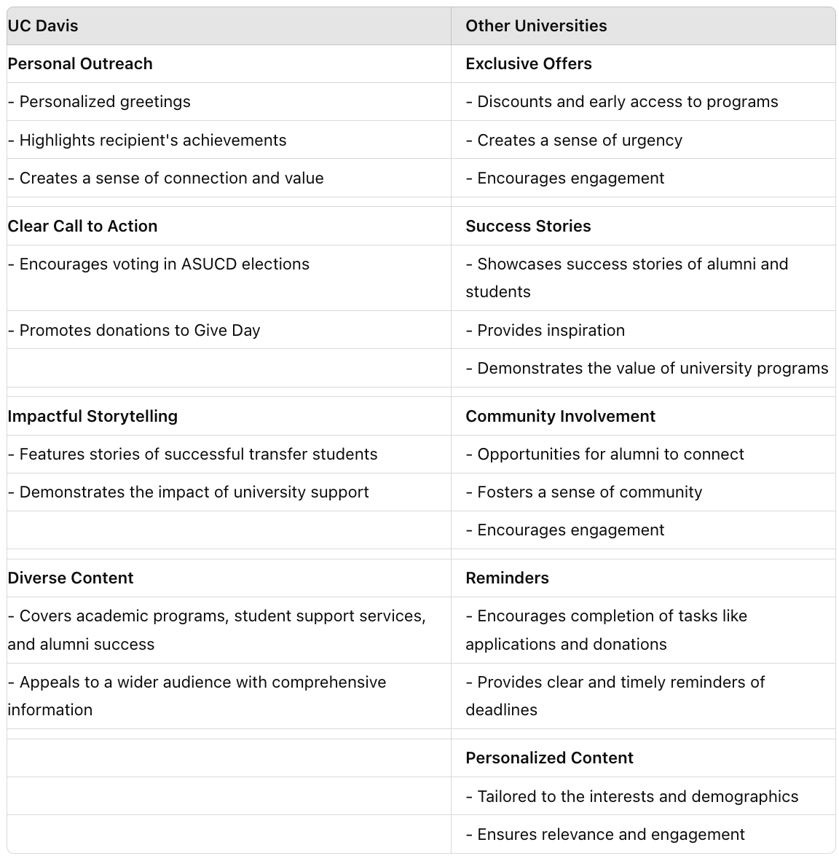
Question 1
Amazon Sales Dataset
The data of 1K+ Amazon Product's Ratings and Reviews as per their details listed on the official website of Amazon with 16 features as following:
product_id
product_name
category •
discounted_price
actual_price •
discount_percentage
rating•
rating_count
about_product
user_id•
user_name•
review_id
review_title•
review_content•
img_link•
product_link
| 3

Slide 52
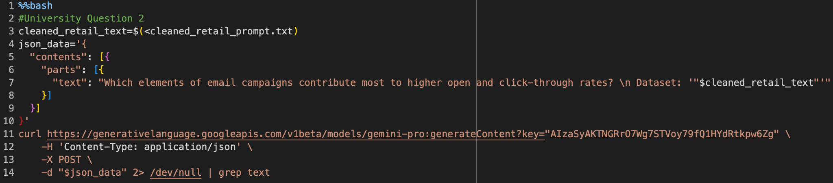
Question 2
2. Which elements of email campaigns contribute most to higher open and
click-through rates?
Amazon Sales Dataset
The data of 1K+ Amazon Product's Ratings and Reviews as per their details listed on the official website of Amazon with 16 features as following:
product_id
product_name
category •
discounted_price
actual_price •
discount_percentage
rating•
rating_count
about_product
user_id•
user_name•
review_id
review_title•
review_content•
img_link•
product_link
| 3

Slide 53
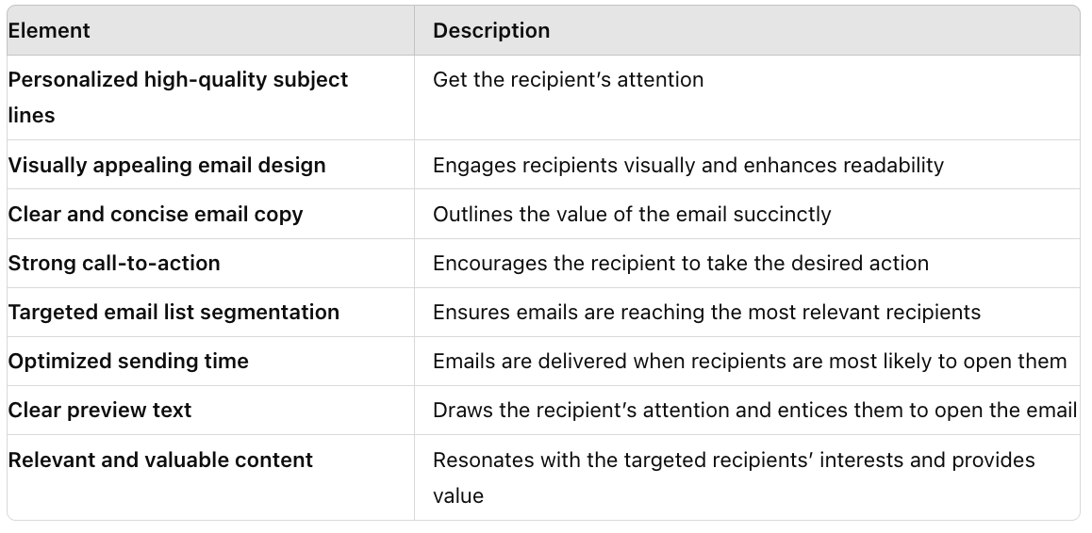
Question 2
Amazon Sales Dataset
The data of 1K+ Amazon Product's Ratings and Reviews as per their details listed on the official website of Amazon with 16 features as following:
product_id
product_name
category •
discounted_price
actual_price •
discount_percentage
rating•
rating_count
about_product
user_id•
user_name•
review_id
review_title•
review_content•
img_link•
product_link
| 3

Slide 54
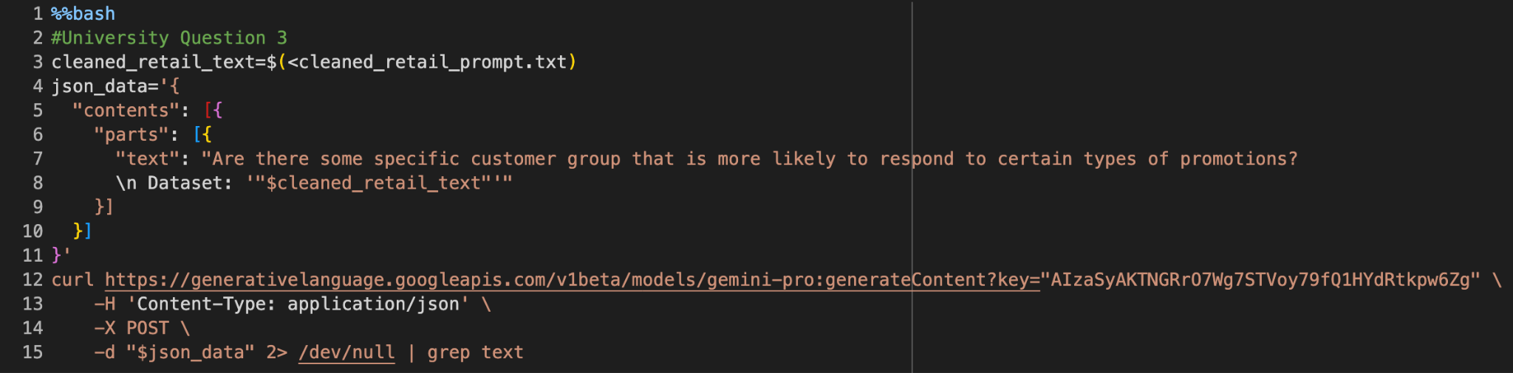
Question 3
3. Are there some specific customer group that is more likely to respond
to certain types of promotions?
Amazon Sales Dataset
The data of 1K+ Amazon Product's Ratings and Reviews as per their details listed on the official website of Amazon with 16 features as following:
product_id
product_name
category •
discounted_price
actual_price •
discount_percentage
rating•
rating_count
about_product
user_id•
user_name•
review_id
review_title•
review_content•
img_link•
product_link
| 3

Slide 55
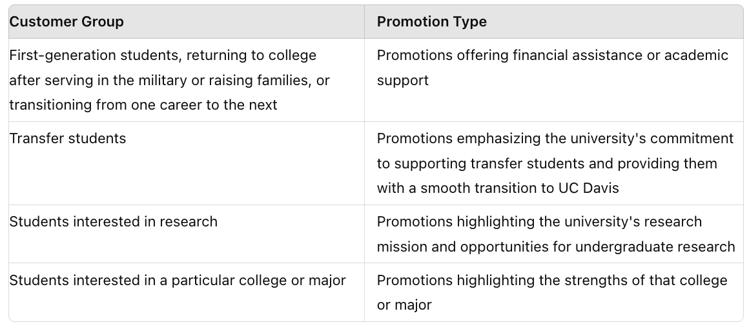
Question 3
Amazon Sales Dataset
The data of 1K+ Amazon Poduct's Ratings and Reviews as per their details listed on the official website of Amazon with 16 features as following:
product_id
product_name
category •
discounted_price
actual_price •
discount_percentage
rating•
rating_count
about_product
user_id•
user_name•
review_id
review_title•
review_content•
img_link•
product_link
| 3

Slide 56
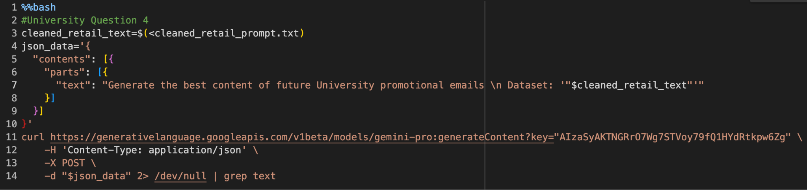
Question 4
4. Generate the best content of future University promotional emails
Amazon Sales Dataset
The data of 1K+ Amazon Product's Ratings and Reviews as per their details listed on the official website of Amazon with 16 features as following:
product_id
product_name
category •
discounted_price
actual_price •
discount_percentage
rating•
rating_count
about_product
user_id•
user_name•
review_id
review_title•
review_content•
img_link•
product_link
| 3

Slide 57
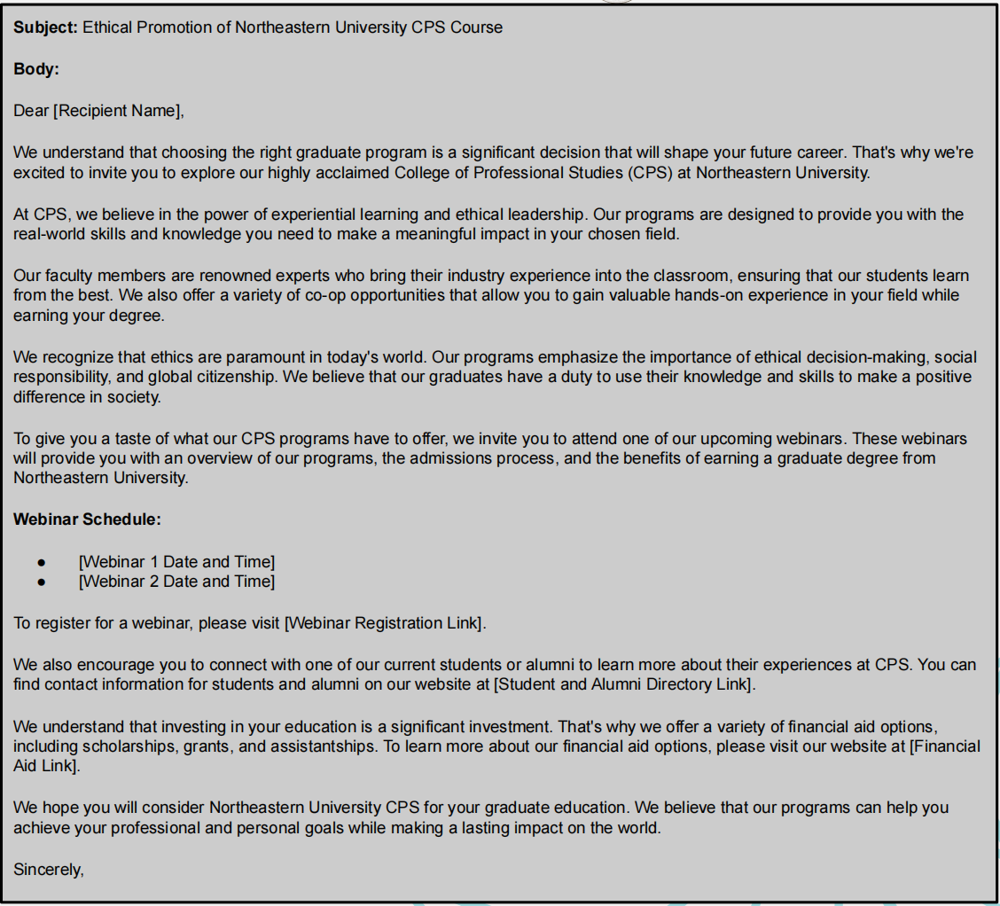
Question 4
Amazon Sales Dataset
The data of 1K+ Amazon Product's Ratings and Reviews as per their details listed on the official website of Amazon with 16 features as following:
product_id
product_name
category •
discounted_price
actual_price •
discount_percentage
rating•
rating_count
about_product
user_id•
user_name•
review_id
review_title•
review_content•
img_link•
product_link
| 3

Slide 58

Question 5
5. What are the sentiment and the theme of these University emails?
Amazon Sales Dataset
The data of 1K+ Amazon Product's Ratings and Reviews as per their details listed on the official website of Amazon with 16 features as following:
product_id
product_name
category •
discounted_price
actual_price •
discount_percentage
rating•
rating_count
about_product
user_id•
user_name•
review_id
review_title•
review_content•
img_link•
product_link
| 3

Slide 59

Question 5
Amazon Sales Dataset
The data of 1K+ Amazon Poduct's Ratings and Reviews as per their details listed on the official website of Amazon with 16 features as following:
product_id
product_name
category •
discounted_price
actual_price •
discount_percentage
ratin
rating_count
about_product
user_id•
user_name•
review_id
P
-P
img_link•
product_link
| 3

Slide 60

Question 6
6. What common themes or offers are most frequently mentioned in these University
emails?
Amazon Sales Dataset
The data of 1K+ Amazon Product's Ratings and Reviews as per their details listed on the official website of Amazon with 16 features as following:
product_id
product_name
category •
discounted_price
actual_price •
discount_percentage
rating•
rating_count
about_product
user_id•
user_name•
review_id
review_title•
review_content•
img_link•
product_link
| 3

Slide 61

Question 6
Amazon Sales Dataset
The data of 1K+ Amazon Poduct's Ratings and Reviews as per their details listed on the official website of Amazon with 16 features as following:
product_id
product_name
category •
discounted_price
actual_price •
discount_percentage
rating•
rating_count
about_product
user_id•
user_name•
review_id
review_title•
review_content•
img_link•
product_link
| 3

Slide 62

Question 7
7. What are the differences in strategies between these University emails targeted at members versus those targeted at the general audience?
Amazon Sales Dataset
The data of 1K+ Amazon Product's Ratings and Reviews as per their details listed on the official website of Amazon with 16 features as following:
product_id
product_name
category •
discounted_price
actual_price •
discount_percentage
rating•
rating_count
about_product
user_id•
user_name•
review_id
review_title•
review_content•
img_link•
product_link
| 3

Slide 63

Question 7
Amazon Sales Dataset
The data of 1K+ Amazon Poduct's Ratings and Reviews as per their details listed on the official website of Amazon with 16 features as following:
product_id
product_name
category •
discounted_price
actual_price •
discount_percentage
rating•
rating_count
about_product
user_id•
user_name•
review_id
review_title•
review_content•
img_link•
product_link
| 3

Slide 64

Question 8
8. What are the common themes in the email copy used for seasonal promotions
versus everyday promotions?
Amazon Sales Dataset
The data of 1K+ Amazon Product's Ratings and Reviews as per their details listed on the official website of Amazon with 16 features as following:
product_id
product_name
category •
discounted_price
actual_price •
discount_percentage
rating•
rating_count
about_product
user_id•
user_name•
review_id
review_title•
review_content•
img_link•
product_link
| 3

Slide 65

Question 8
Amazon Sales Dataset
The data of 1K+ Amazon Poduct's Ratings and Reviews as per their details listed on the official website of Amazon with 16 features as following:
product_id
product_name
category •
discounted_price
actual_price •
discount_percentage
rating•
rating_count
about_product
user_id•
user_name•
review_id
review_title•
review_content•
img_link•
product_link
| 3

Slide 66

Question 9
9. What are the recurring themes or values communicated through these emails?
Amazon Sales Dataset
The data of 1K+ Amazon Product's Ratings and Reviews as per their details listed on the official website of Amazon with 16 features as following:
product_id
product_name
category •
discounted_price
actual_price •
discount_percentage
rating•
rating_count
about_product
user_id•
user_name•
review_id
review_title•
review_content•
img_link•
product_link
| 3

Slide 67

Question 9
Amazon Sales Dataset
The data of 1K+ Amazon Poduct's Ratings and Reviews as per their details listed on the official website of Amazon with 16 features as following:
Sure, here is the information organized in a table format:
| **Recurring Themes** | **Communicated Values** |
|----------------------|--------------------------|
| **Value and savings:** Many emails emphasize discounts, coupons, and free items to attract customers and build loyalty. | **Customer appreciation:** Restaurants express gratitude to customers, offering rewards, bonuses, and special treatment. |
| **Convenience:** Emails promote convenient ordering options such as mobile apps, online ordering, and delivery services. | **Healthy choices:** Some emails highlight the availability of healthy options, such as salads, fruits, and vegetables. |
| **Membership benefits:** Restaurants offer exclusive rewards, discounts, and perks to members of their loyalty programs or subscription services. | **Community involvement:** Restaurants encourage customers to connect with their communities by participating in local events and supporting charitable causes. |
| **New and seasonal offerings:** Emails frequently showcase new menu items and special promotions to entice customers. | **Quality and freshness:** Emails emphasize the use of fresh ingredients and high-quality food preparation to promote trust and satisfaction. |
| | **Family-friendly atmosphere:** Restaurants cater to families by offering Kids Eat Free programs, comfortable seating, and kid-friendly menu options. |
product_id
product_name
category •
discounted_price
actual_price •
discount_percentage
rating•
rating_count
about_product
user_id•
user_name•
review_id
review_title•
review_content•
img_link•
product_link
| 3

Slide 68

Question 10
10. Are there any ethical or compliance issues related to the content or targeting of
these promotions?
Amazon Sales Dataset
The data of 1K+ Amazon Product's Ratings and Reviews as per their details listed on the official website of Amazon with 16 features as following:
product_id
product_name
category •
discounted_price
actual_price •
discount_percentage
rating•
rating_count
about_product
user_id•
user_name•
review_id
review_title•
review_content•
img_link•
product_link
| 3

Slide 69

Question 10
Amazon Sales Dataset
The data of 1K+ Amazon Poduct's Ratings and Reviews as per their details listed on the official website of Amazon with 16 features as following:
product_id
product_name
category •
discounted_price
actual_price •
discount_percentage
rating•
rating_count
about_product
user_id•
user_name•
review_id
review_title•
review_content•
img_link•
product_link
| 3

Slide 70
Tourism emails

Slide 71

P
Set up for tourism Qs
Amazon Sales Dataset
The data of 1K+ Amazon Product's Ratings and Reviews as per their details listed on the official website of Amazon with 16 features as following:
product_id
product_name
category •
discounted_price
actual_price •
discount_percentage
rating•
rating_count
about_product
user_id•
user_name•
review_id
review_title•
review_content•
img_link•
product_link
| 3

Slide 72

Question 1
1. What promotion strategies in these Tourism emails that can attract
more users?
Amazon Sales Dataset
The data of 1K+ Amazon Product's Ratings and Reviews as per their details listed on the official website of Amazon with 16 features as following:
product_id
product_name
category •
discounted_price
actual_price •
discount_percentage
rating•
rating_count
about_product
user_id•
user_name•
review_id
review_title•
review_content•
img_link•
product_link
| 3

Slide 73
Question 1
1. What promotion strategies in these Tourism emails that can attract
more users?
Personalized and Exclusive Experiences
Customized Itinerary Creation: Tailor itineraries to individual interests and preferences for unique and memorable experiences.
Exclusive Access and Behind-the-Scenes Tours: Provide access to private areas, exclusive tours, and meet-and-greets with local experts to create a sense of exclusivity and intimacy.
Value-Added Incentives
Bundle Packages and Discounts: Offer package deals combining multiple experiences at discounted rates to provide greater value and encourage extended stays.
Loyalty Programs: Implement programs that reward repeat customers with exclusive perks, discounts, and priority access to foster long-term relationships.
Immersive and Engaging Experiences
Interactive Activities and Scavenger Hunts: Create activities that engage tourists in the history and culture of their destination, making experiences more memorable.
Virtual Reality and Augmented Reality Experiences: Use emerging technologies to offer immersive experiences, allowing tourists to explore from a unique perspective.
Personalized Recommendations and Curated Content
Personalized Recommendations: Provide tailored suggestions based on tourists' preferences, interests, and past experiences to help them discover hidden gems.
Curated Content and Inspiration: Share captivating blogs, videos, and social media posts to inspire and educate tourists, fostering a connection with the destination.
Gamification and Social Integration
Gamification: Incorporate elements like points, badges, and leaderboards to encourage participation and create a sense of competition.
Social Integration: Facilitate sharing of experiences and connection through social media to build a community around the destination.
Amazon Sales Dataset
The data of 1K+ Amazon Product's Ratings and Reviews as per their details listed on the official website of Amazon with 16 features as following:
product_id
product_name
category •
discounted_price
actual_price •
discount_percentage
rating•
rating_count
about_product
user_id•
user_name•
review_id
review_title•
review_content•
img_link•
product_link
| 3

Slide 74

Question 2
2. Which elements of email campaigns contribute most to higher open and click-through rates?
Amazon Sales Dataset
The data of 1K+ Amazon Product's Ratings and Reviews as per their details listed on the official website of Amazon with 16 features as following:
product_id
product_name
category •
discounted_price
actual_price •
discount_percentage
rating•
rating_count
about_product
user_id•
user_name•
review_id
review_title•
review_content•
img_link•
product_link
| 3

Slide 75

Question 2
2. Which elements of email campaigns contribute most to higher open and click-through rates?
Amazon Sales Dataset
The data of 1K+ Amazon Product's Ratings and Reviews as per their details listed on the official website of Amazon with 16 features as following:
product_id
product_name
category •
discounted_price
actual_price •
discount_percentage
rating•
rating_count
about_product
user_id•
user_name•
review_id
review_title•
review_content•
img_link•
product_link
| 3

Slide 76

Question 3
2. Which elements of email campaigns contribute most to higher open and click-through rates?
Amazon Sales Dataset
The data of 1K+ Amazon Product's Ratings and Reviews as per their details listed on the official website of Amazon with 16 features as following:
product_id
product_name
category •
discounted_price
actual_price •
discount_percentage
rating•
rating_count
about_product
user_id•
user_name•
review_id
review_title•
review_content•
img_link•
product_link
| 3

Slide 77

Question 3
3. Are there some specific customer group that is more likely to respond to certain types of promotions?
Amazon Sales Dataset
The data of 1K+ Amazon Product's Ratings and Reviews as per their details listed on the official website of Amazon with 16 features as following:
product_id
product_name
category •
discounted_price
actual_price •
discount_percentage
rating•
rating_count
about_product
user_id•
user_name•
review_id
review_title•
review_content•
img_link•
product_link
"text": "There is not enough information in the context to determine which type of customers are most likely to respond to specific types of marketing promotions."
| 3

Slide 78

Question 4
4. Generate the best content of future Tourism promotional emails
Amazon Sales Dataset
The data of 1K+ Amazon Product's Ratings and Reviews as per their details listed on the official website of Amazon with 16 features as following:
product_id
product_name
category •
discounted_price
actual_price •
discount_percentage
rating•
rating_count
about_product
user_id•
user_name•
review_id
review_title•
review_content•
img_link•
product_link
| 3

Slide 79
Question 4
4. Generate the best content of future Tourism promotional emails
Embark on Unforgettable Adventures with Our Exclusive Experiences
Body: Prepare yourself for an extraordinary journey as we unveil our captivating selection of exclusive experiences, meticulously curated to elevate your travel adventures to unparalleled heights.
Private After-Hours Duomo Tour, Florence Explore the iconic Duomo from top to bottom after dark. Witness the cathedral's closing ceremony with the Key Master, an experience reserved exclusively for a select few.
Alone in the Alcazar Exclusive Early Access Tour, Seville Immerse yourself in the artistic heart of Seville on a private, after-hours tour. Skip the lines, relish in a secret vineyard tasting, and experience breathtaking Sacr-Coeur views.
Voyage to the Falls Boat Tour, Niagara Falls Get up close and personal with the thundering Niagara Falls on an exhilarating boat tour. Feel the spray on your face and capture awe-inspiring memories.
Taste of Montmartre, Paris Join us for a unique afternoon tea while taking in stunning views of London's iconic landmarks. Indulge in exquisite finger foods and premium tea service as you sail.
Crafted Pizza in Trastevere, Rome Uncover the secrets of Italy's pizza royalty on a small group journey. Master dough-making under a renowned chef and savor an authentic Roman meal.
Call to Action: Don't wait to create memories that will last a lifetime! Book your exclusive experience today and embark on an adventure that will captivate your senses and ignite your wanderlust. Visit our website or contact our concierge team for more information and to secure your spot.
Amazon Sales Dataset
The data of 1K+ Amazon Product's Ratings and Reviews as per their details listed on the official website of Amazon with 16 features as following:
product_id
product_name
category •
discounted_price
actual_price •
discount_percentage
rating•
rating_count
about_product
user_id•
user_name•
review_id
review_title•
review_content•
img_link•
product_link
| 3

Slide 80

Question 5
5. What are the sentiment and the theme of these Tourism emails?
Amazon Sales Dataset
The data of 1K+ Amazon Product's Ratings and Reviews as per their details listed on the official website of Amazon with 16 features as following:
product_id
product_name
category •
discounted_price
actual_price •
discount_percentage
rating•
rating_count
about_product
user_id•
user_name•
review_id
review_title•
review_content•
img_link•
product_link
| 3

Slide 81

Question 5
5. What are the sentiment and the theme of these Tourism emails?
Amazon Sales Dataset
The data of 1K+ Amazon Product's Ratings and Reviews as per their details listed on the official website of Amazon with 16 features as following:
product_id
product_name
category •
discounted_price
actual_price •
discount_percentage
rating•
rating_count
about_product
user_id•
user_name•
review_id
review_title•
review_content•
img_link•
product_link
| 3

Slide 82


Question 5
5. What are the sentiment and the theme of these Tourism emails?
Amazon Sales Dataset
The data of 1K+ Amazon Product's Ratings and Reviews as per their details listed on the official website of Amazon with 16 features as following:
Positive(29) > Negative(1)
product_id
product_name
category •
discounted_price
actual_price •
discount_percentage
rating•
rating_count
about_product
user_id•
user_name•
review_id
review_title•
review_content•
img_link•
product_link
| 3

Slide 83

Question 6
6. What common themes or offers are most frequently mentioned in these Tourism emails?
Amazon Sales Dataset
The data of 1K+ Amazon Product's Ratings and Reviews as per their details listed on the official website of Amazon with 16 features as following:
product_id
product_name
category •
discounted_price
actual_price •
discount_percentage
rating•
rating_count
about_product
user_id•
user_name•
review_id
review_title•
review_content•
img_link•
product_link
| 3

Slide 84
Question 6
Common Themes:
Exclusive Experiences and Access: These emails often offer unique and exclusive experiences, such as after-hours access to attractions, private tours, and VIP cruises.
Memorable Moments: Emphasis is placed on creating unforgettable memories and special occasions, including Valentine's Day, Mother's Day, and family vacations.
Culinary Delights: Focus on culinary experiences such as food tours, cooking classes, and fine dining cruises.
Historical and Cultural Immersion: Offering historical and cultural experiences, such as guided tours of iconic landmarks, visits to museums, and historical reenactments.
Seasonal Experiences: Featuring seasonal offers like cherry blossom viewing cruises in the spring and holiday-themed events in the winter.
Common Offers:
Discounts and Promotions: Includes deals and promotions on experiences, such as Black Friday deals and early booking incentives.
Free Gifts and Bonuses: Some emails offer free gifts or bonuses, such as gift cards and complimentary drinks with purchases.
Package Deals: Often includes package deals that combine multiple experiences, such as dinner and a show, or a tour and a meal.
Personalized Recommendations: Offers personalized recommendations based on user preferences and past experiences.
Gift Vouchers: Includes gift vouchers that can be used to purchase experiences for friends and family.
Amazon Sales Dataset
The data of 1K+ Amazon Product's Ratings and Reviews as per their details listed on the official website of Amazon with 16 features as following:
product_id
product_name
category •
discounted_price
actual_price •
discount_percentage
rating•
rating_count
about_product
user_id•
user_name•
review_id
review_title•
review_content•
img_link•
product_link
| 3

Slide 85

Question 7
7. What are the differences in strategies between these Tourism emails targeted at members versus those targeted at the general audience?
Amazon Sales Dataset
The data of 1K+ Amazon Product's Ratings and Reviews as per their details listed on the official website of Amazon with 16 features as following:
product_id
product_name
category •
discounted_price
actual_price •
discount_percentage
rating•
rating_count
about_product
user_id•
user_name•
review_id
review_title•
review_content•
img_link•
product_link
| 3

Slide 86
Question 7
Tourism Emails Targeted at Members:
Personalized Experiences: Emphasize exclusive access to VIP experiences, special offers, and personalized recommendations tailored to the member's interests and travel preferences.
Member-Only Promotions: Provide exclusive discounts, loyalty rewards, and early access to new tours and experiences.
Community Building: Foster a sense of community among members by sharing travel tips, hosting online events, and offering opportunities for member-only meetups and networking.
Content Tailored to Member Interests: Share curated articles, blog posts, and videos related to the destinations and activities that members are most interested in.
Tourism Emails Targeted at the General Audience:
Destination Highlights: Showcase popular destinations, iconic landmarks, and must-see attractions to inspire wanderlust and generate interest.
Call-to-Action: Encourage bookings by providing clear links to booking pages and highlighting time-sensitive promotions or limited-time offers.
Social Proof: Include testimonials, reviews, and social media mentions to build credibility and establish the brand as a reliable and trusted source of travel information.
General Travel Tips: Offer practical advice on topics such as travel planning, packing essentials, and navigating unfamiliar destinations to enhance the overall travel experience.
Amazon Sales Dataset
The data of 1K+ Amazon Product's Ratings and Reviews as per their details listed on the official website of Amazon with 16 features as following:
product_id
product_name
category •
discounted_price
actual_price •
discount_percentage
rating•
rating_count
about_product
user_id•
user_name•
review_id
review_title•
review_content•
img_link•
product_link
| 3

Slide 87

Question 8
8. What are the common themes in the email copy used for seasonal promotions versus everyday promotions?
Amazon Sales Dataset
The data of 1K+ Amazon Product's Ratings and Reviews as per their details listed on the official website of Amazon with 16 features as following:
product_id
product_name
category •
discounted_price
actual_price •
discount_percentage
rating•
rating_count
about_product
user_id•
user_name•
review_id
review_title•
review_content•
img_link•
product_link
| 3

Slide 88
Question 8
Common Themes in Email Copy for Seasonal Promotions:
Sense of Urgency: Limited-time offers, exclusive discounts, and time-sensitive promotions create a sense of urgency and encourage immediate action.
Emotional Appeal: Seasonal themes evoke emotions associated with the time of year, such as excitement for summer, nostalgia for fall, or warmth for winter.
Focus on Experiences: Centered around creating memorable experiences, such as holiday cruises, festive dining events, or family-friendly activities.
Personalized Offers: Tailored to specific customer segments, offering experiences based on their interests or past purchases.
Emphasis on Gifting: Highlighting gift-giving opportunities, encouraging customers to purchase presents for loved ones or themselves.
Common Themes in Email Copy for Everyday Sales:
Clear Value Proposition: Emphasizes the benefits and value of the product or service being promoted, clearly stating how it meets customer needs.
Product-Focused: Highlights product features, specifications, and why it's a good purchase for the customer.
Use of Language: Direct and persuasive language, using action verbs and persuasive techniques to encourage conversions.
Social Proof: Utilizes testimonials, reviews, and social media mentions to build credibility and trust with potential customers.
Call to Action: Includes a clear call to action, such as "Buy now," "Add to cart," or "Learn more."
Amazon Sales Dataset
The data of 1K+ Amazon Product's Ratings and Reviews as per their details listed on the official website of Amazon with 16 features as following:
product_id
product_name
category •
discounted_price
actual_price •
discount_percentage
rating•
rating_count
about_product
user_id•
user_name•
review_id
review_title•
review_content•
img_link•
product_link
| 3

Slide 89

Question 9
9. What are the recurring themes or values communicated through these emails?
Amazon Sales Dataset
The data of 1K+ Amazon Product's Ratings and Reviews as per their details listed on the official website of Amazon with 16 features as following:
product_id
product_name
category •
discounted_price
actual_price •
discount_percentage
rating•
rating_count
about_product
user_id•
user_name•
review_id
review_title•
review_content•
img_link•
product_link
| 3

Slide 90
Question 9
Recurring Themes or Values in Promotional Emails for Tourism Experiences:
Excitement and Adventure:
Use of words like "exclusive," "unforgettable," and "VIP" to create a sense of excitement and exclusivity.
Highlighting unique and thrilling aspects, such as seeing Alcatraz Island after dark or going on a helicopter tour of New York City.
Luxury and Indulgence:
Emphasis on luxurious and indulgent aspects, such as gourmet meals on dinner cruises or private museum tours.
Use of words like "upscale" and "premium" to convey exclusivity and luxury.
Convenience and Ease:
Highlighting the ease of booking and participating in experiences.
Providing clear booking instructions and offering discounts or promotions to enhance affordability.
Local Expertise:
Emphasis on the local expertise of tour guides and staff.
Showcasing their knowledge and experience to help visitors maximize their experience.
Amazon Sales Dataset
The data of 1K+ Amazon Product's Ratings and Reviews as per their details listed on the official website of Amazon with 16 features as following:
product_id
product_name
category •
discounted_price
actual_price •
discount_percentage
rating•
rating_count
about_product
user_id•
user_name•
review_id
review_title•
review_content•
img_link•
product_link
| 3

Slide 91

Question 10
10. Are there any ethical or compliance issues related to the content or targeting of these promotions?
Amazon Sales Dataset
The data of 1K+ Amazon Product's Ratings and Reviews as per their details listed on the official website of Amazon with 16 features as following:
product_id
product_name
category •
discounted_price
actual_price •
discount_percentage
rating•
rating_count
about_product
user_id•
user_name•
review_id
review_title•
review_content•
img_link•
product_link
"text": "I am unable to find any information related to ethical or compliance issues in this text."
| 3

Slide 92
Thanks
TEAM MEMBERS: Wendy & Lukas

